Slide 1
Moorea 2021 SGD 16S
By me

Slide 2
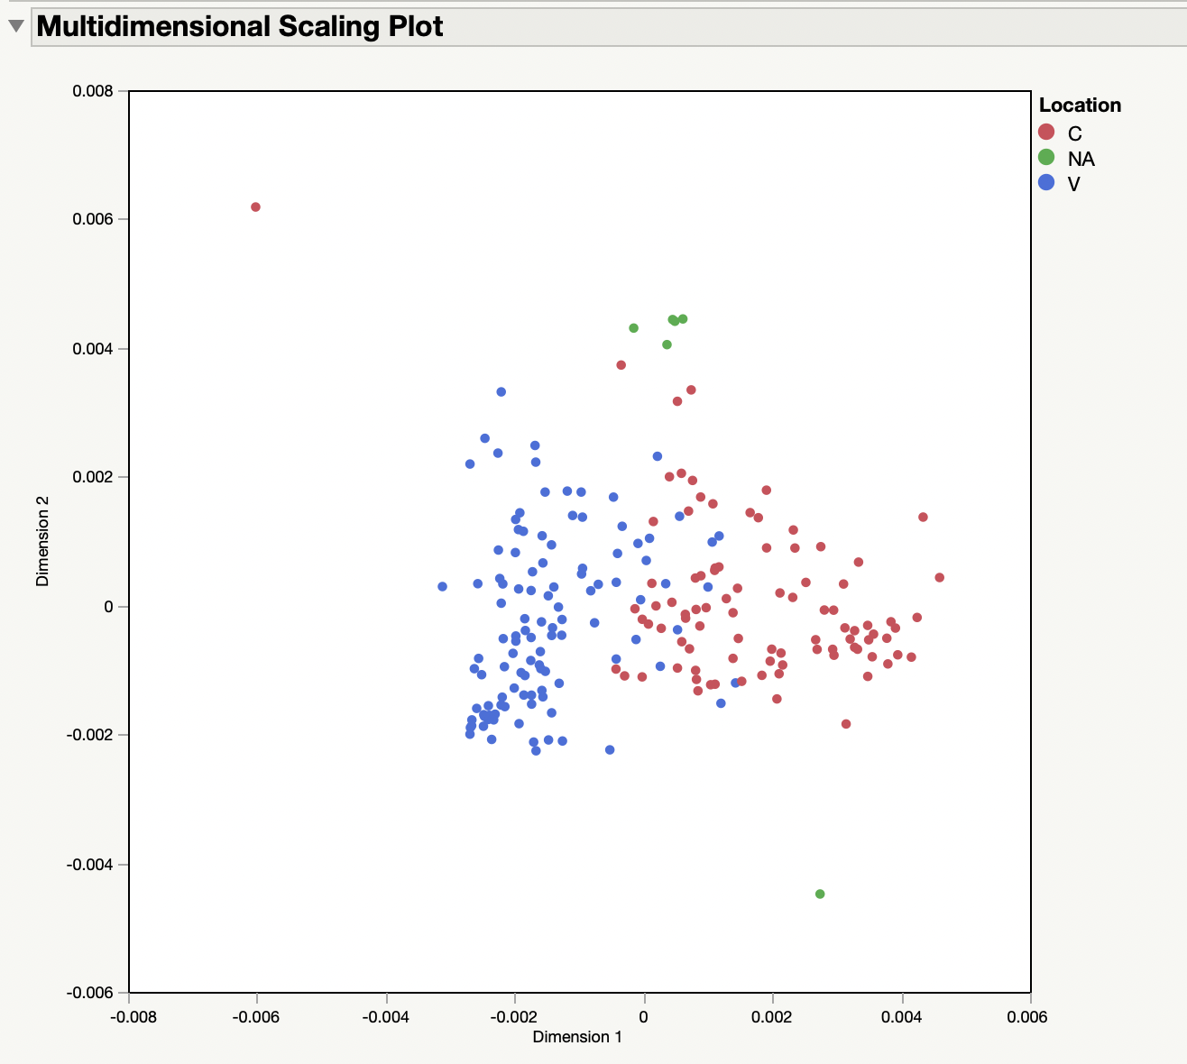
Multidimensional scaling - all samples

Slide 3
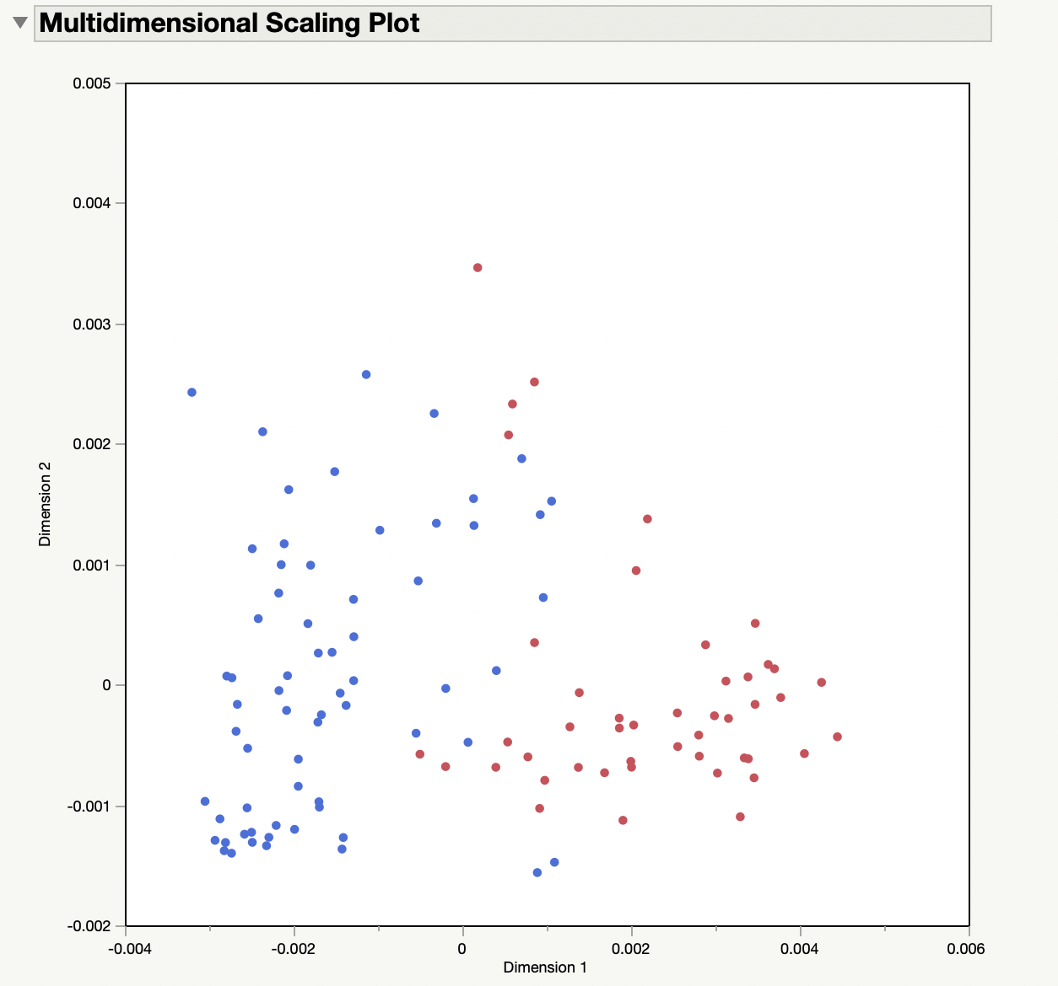
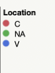
Multidimensional scaling – only Day

Slide 4
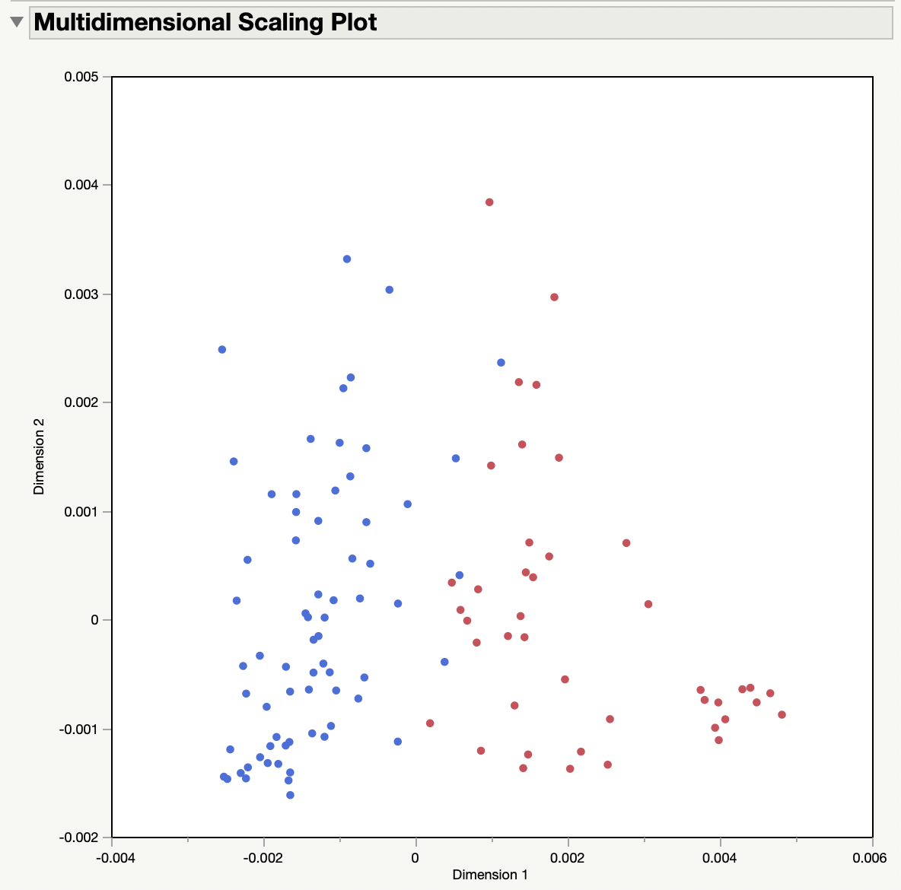
Multidimensional scaling – only Low

Slide 5
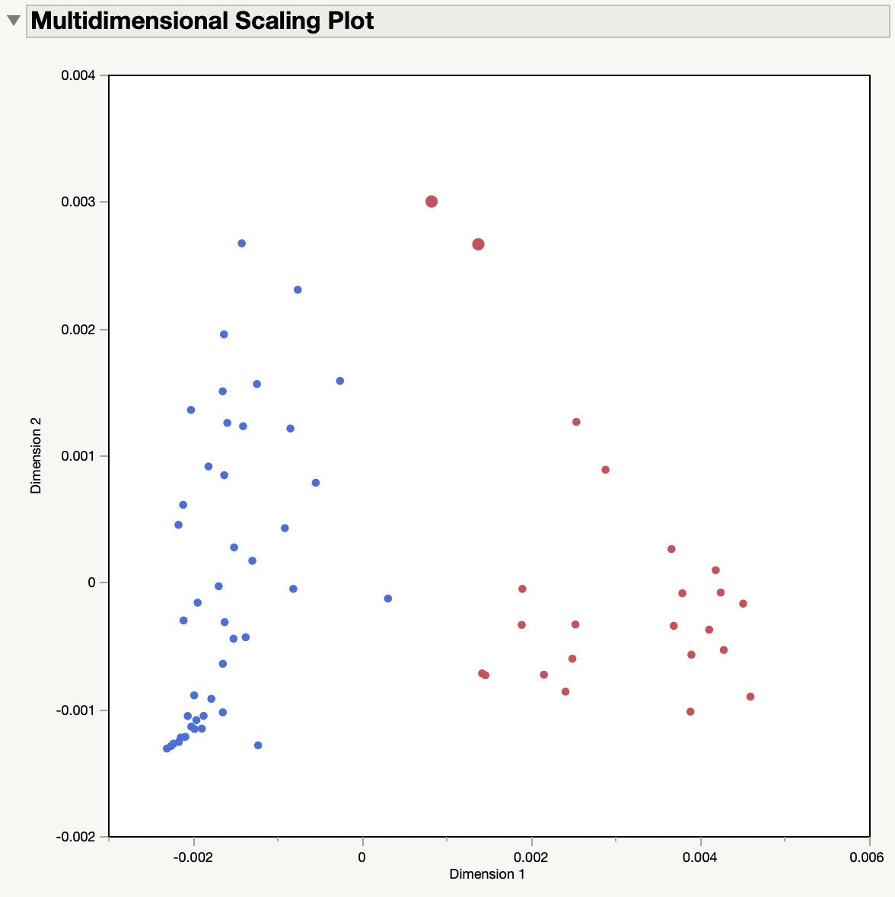
Multidimensional scaling – only Day and Low
Seep Sites
Seep Sites
Sites: Mostly V_L_D_1 ?

Slide 6
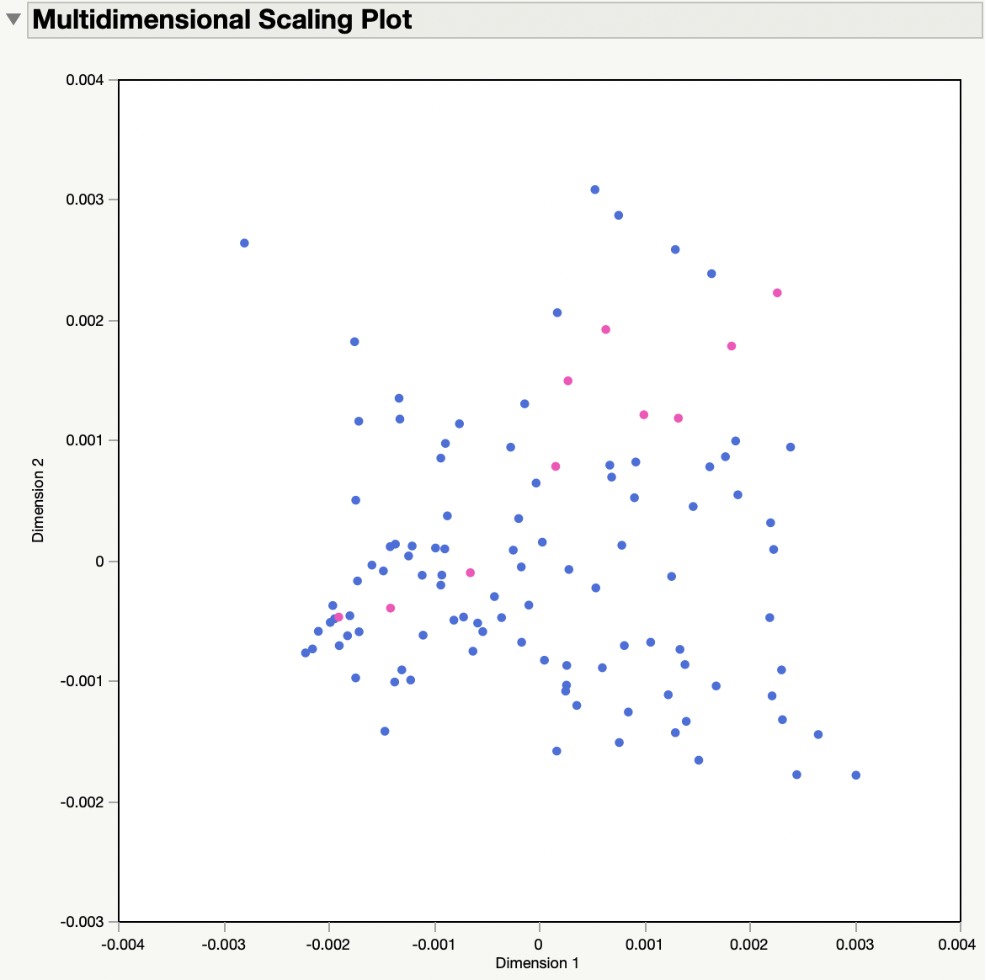
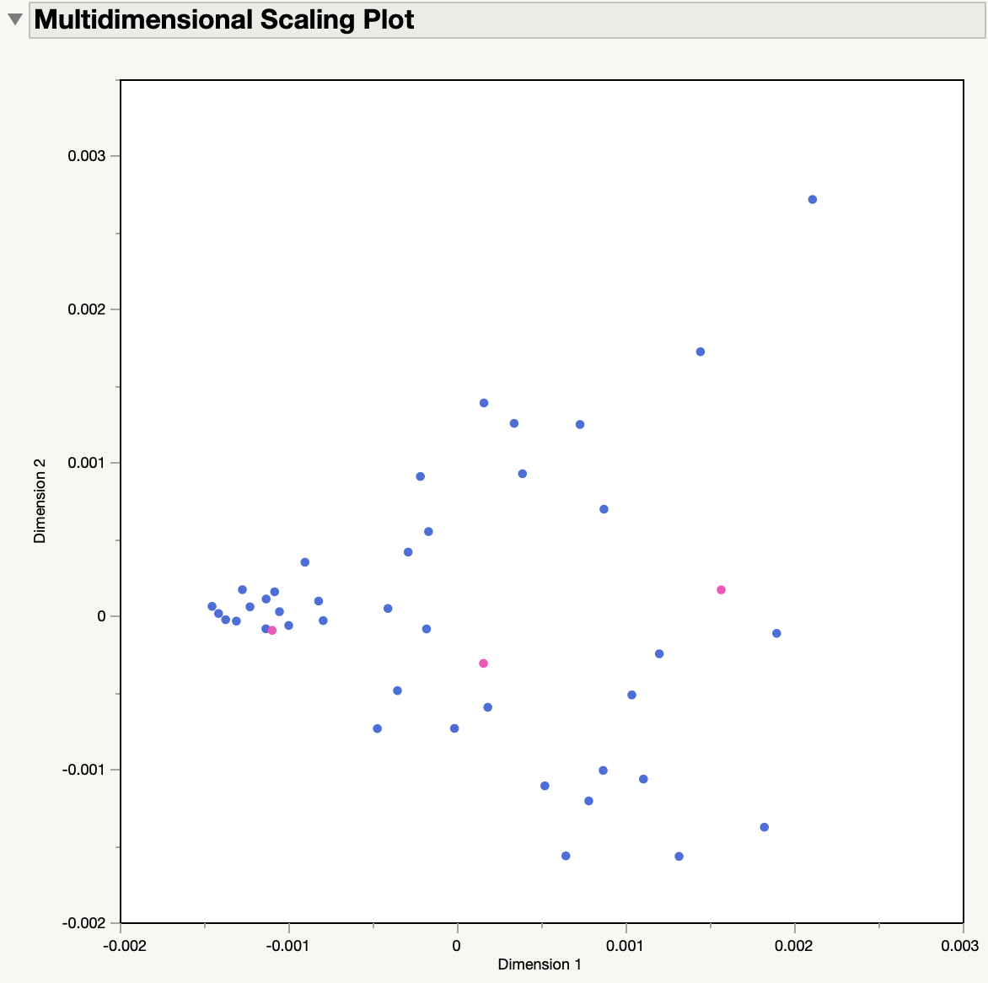
Multidimensional scaling – Verari Seep Points are colored pink
All Samples
Only Low and Day samples

Slide 7
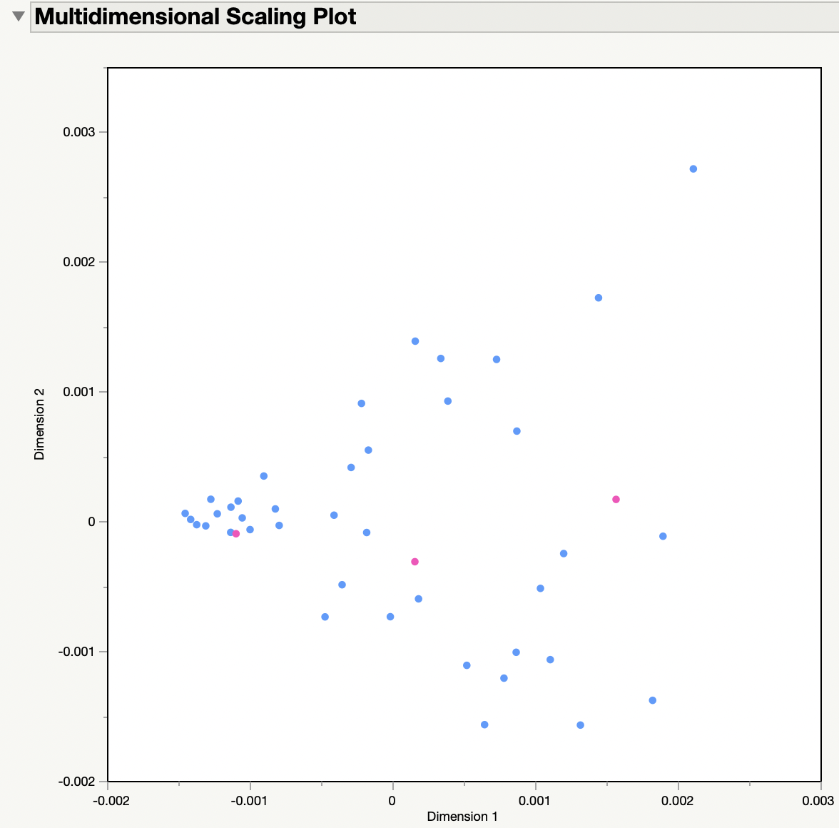
Multidimensional scaling – Verari only Day/Low Seep Points are colored pink
ALL Sites V_L_D_1
Mix of “_1” and “_2”
Seep Sites
This tells me that:
wave action impacts microbial community, could be from sewage
ALL Sites V_L_D_2

Slide 8
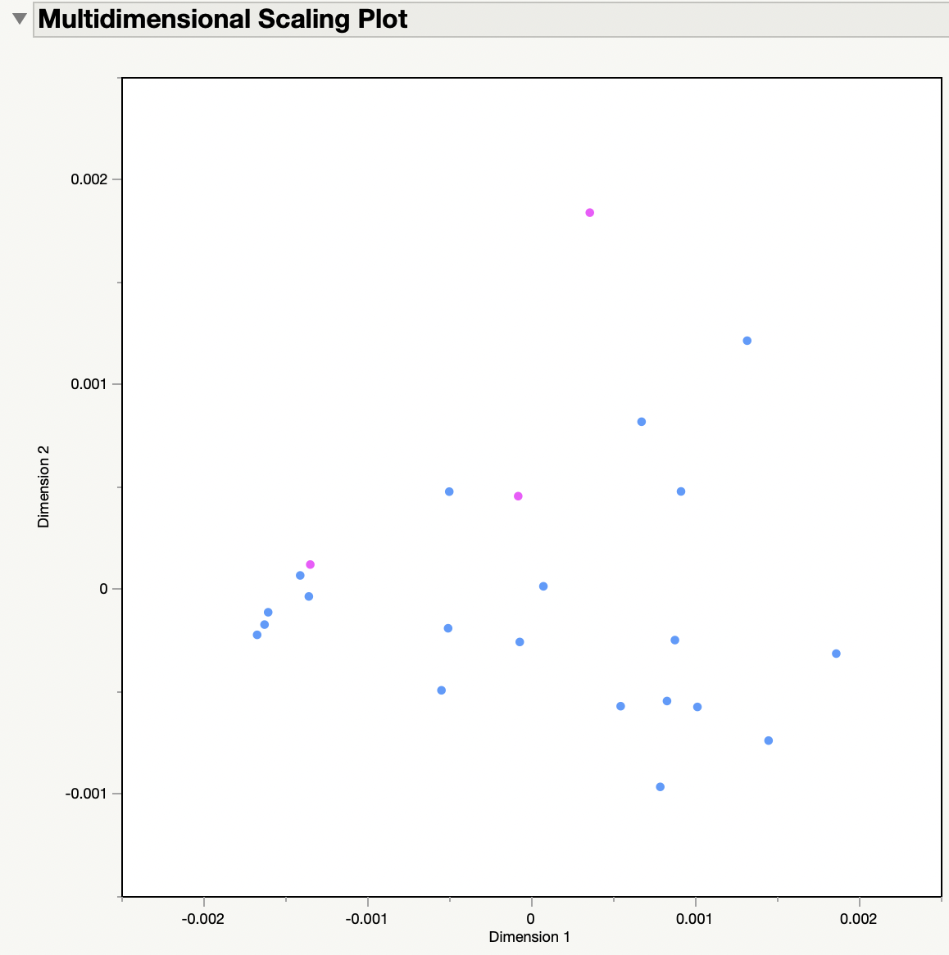
Multidimensional scaling – Verari only Day/Low ”_2” Seep Points are colored pink

Slide 9
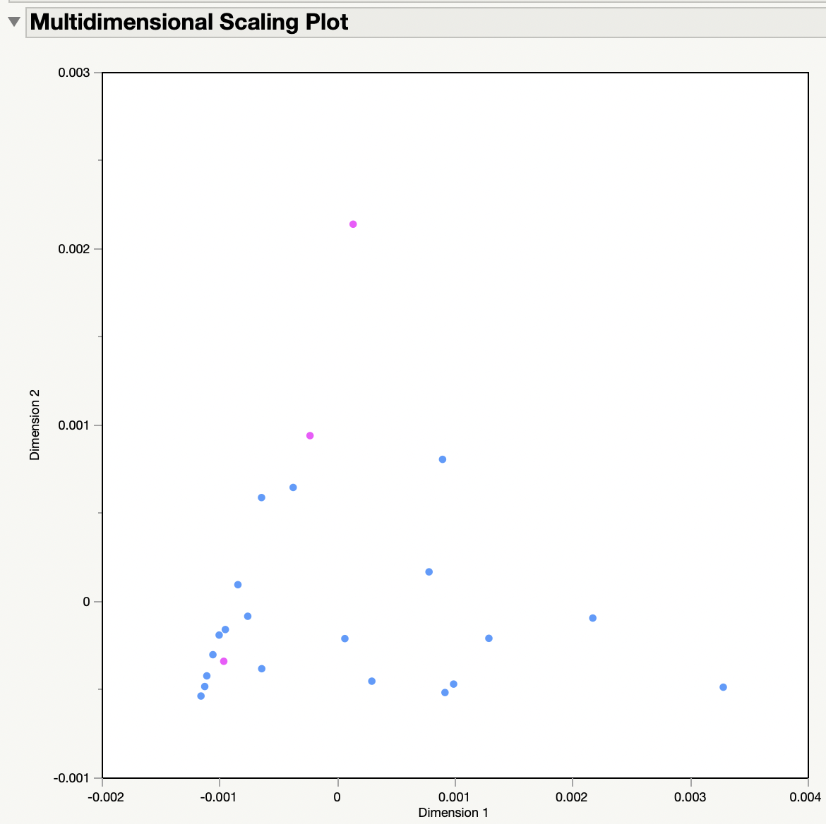
Multidimensional scaling – Verari only Day/Low ”_1” Seep Points are colored pink

Slide 10
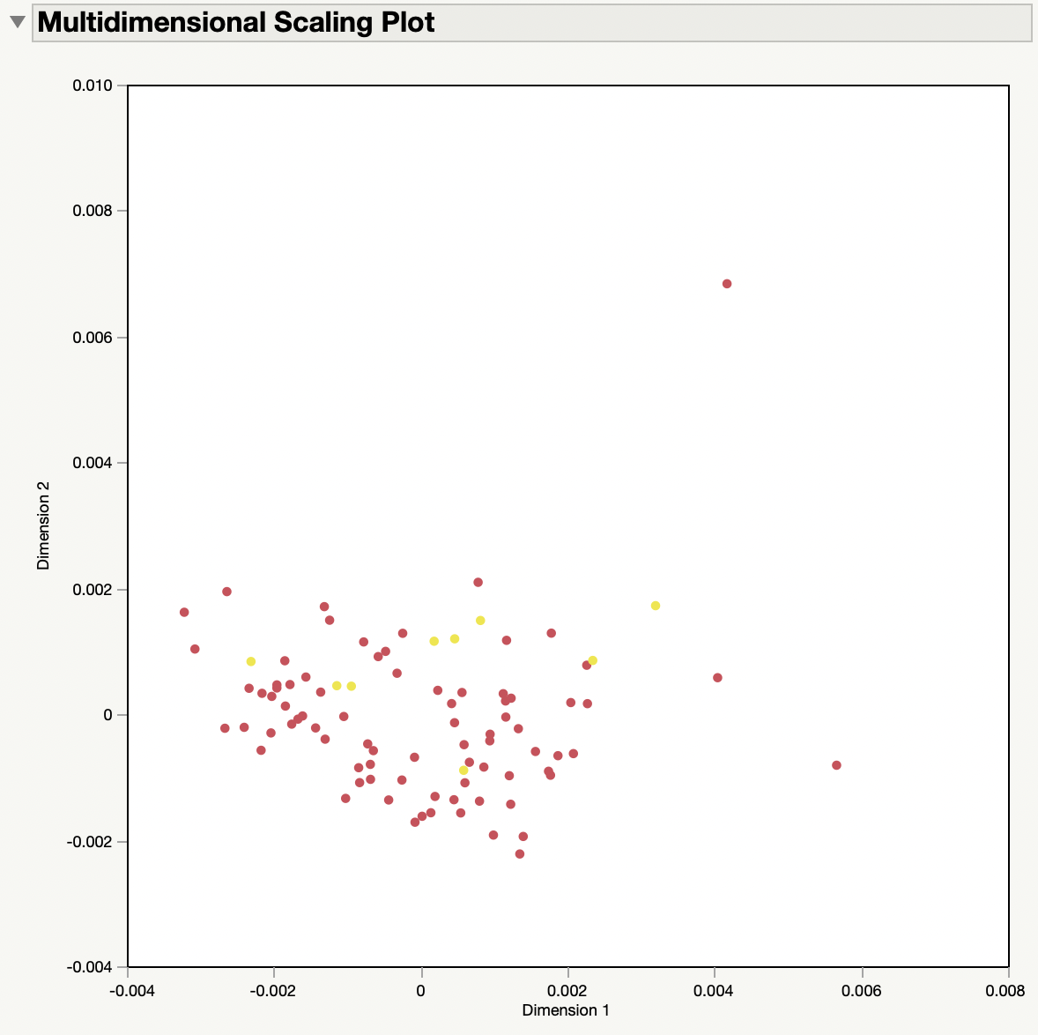
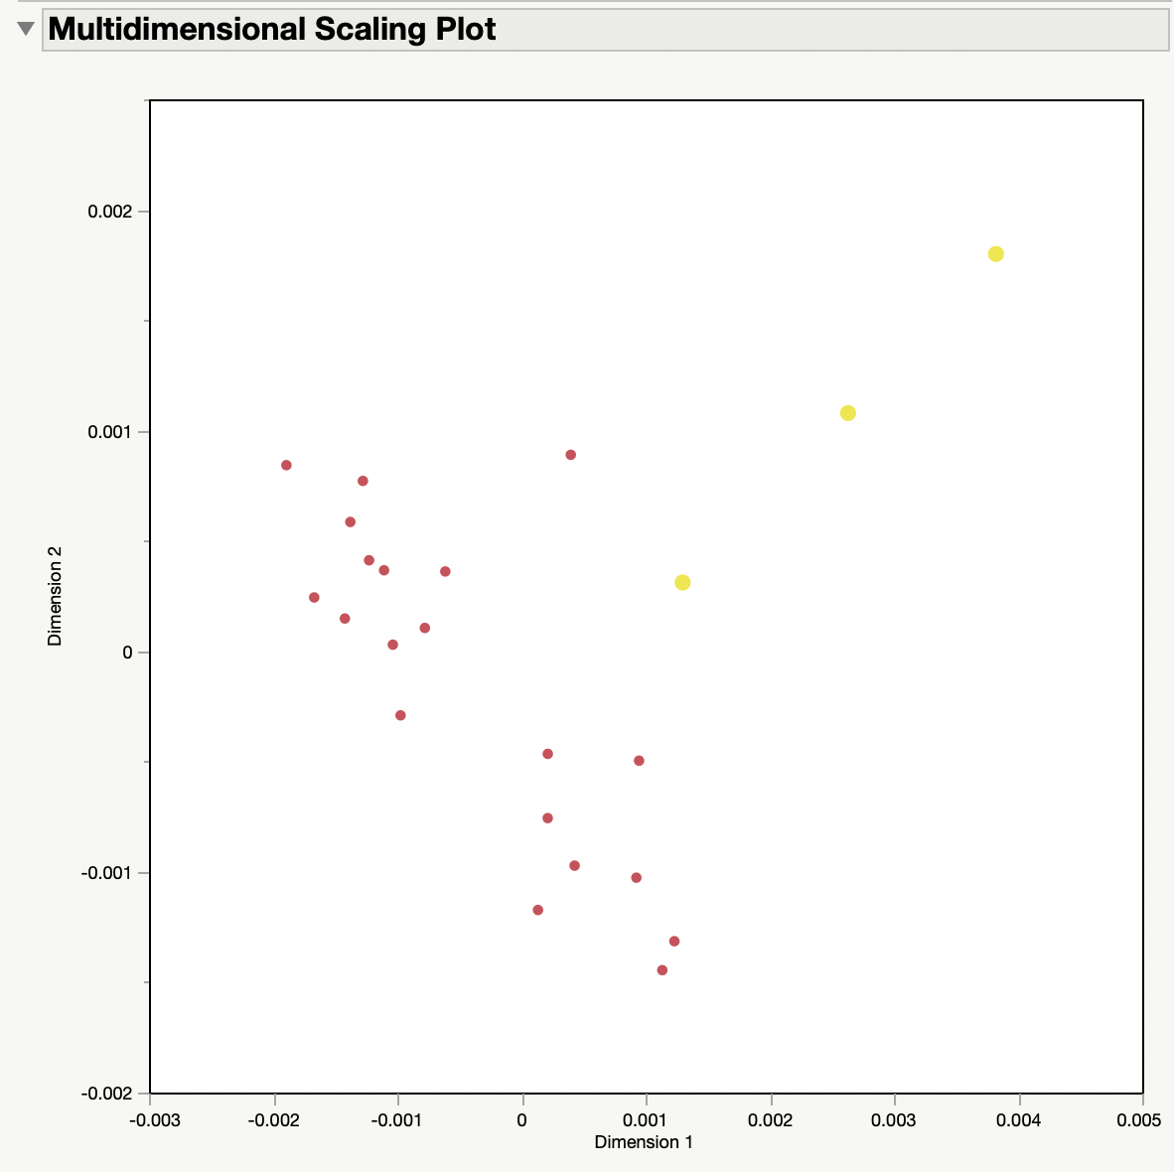
Multidimensional scaling – Cabral Seep Points are colored yellow
All Samples
Only Low and Day samples

Slide 11
Multidimensional scaling – Cabral only Day/Low Seep Points are colored yellow
Sites: 1, 2, 3, 4, 5, 8, 10, 14, 16, 17, 20
Seep Sites
Sites: 6, 7, 9, 11, 12, 15, 18, 19

Slide 12
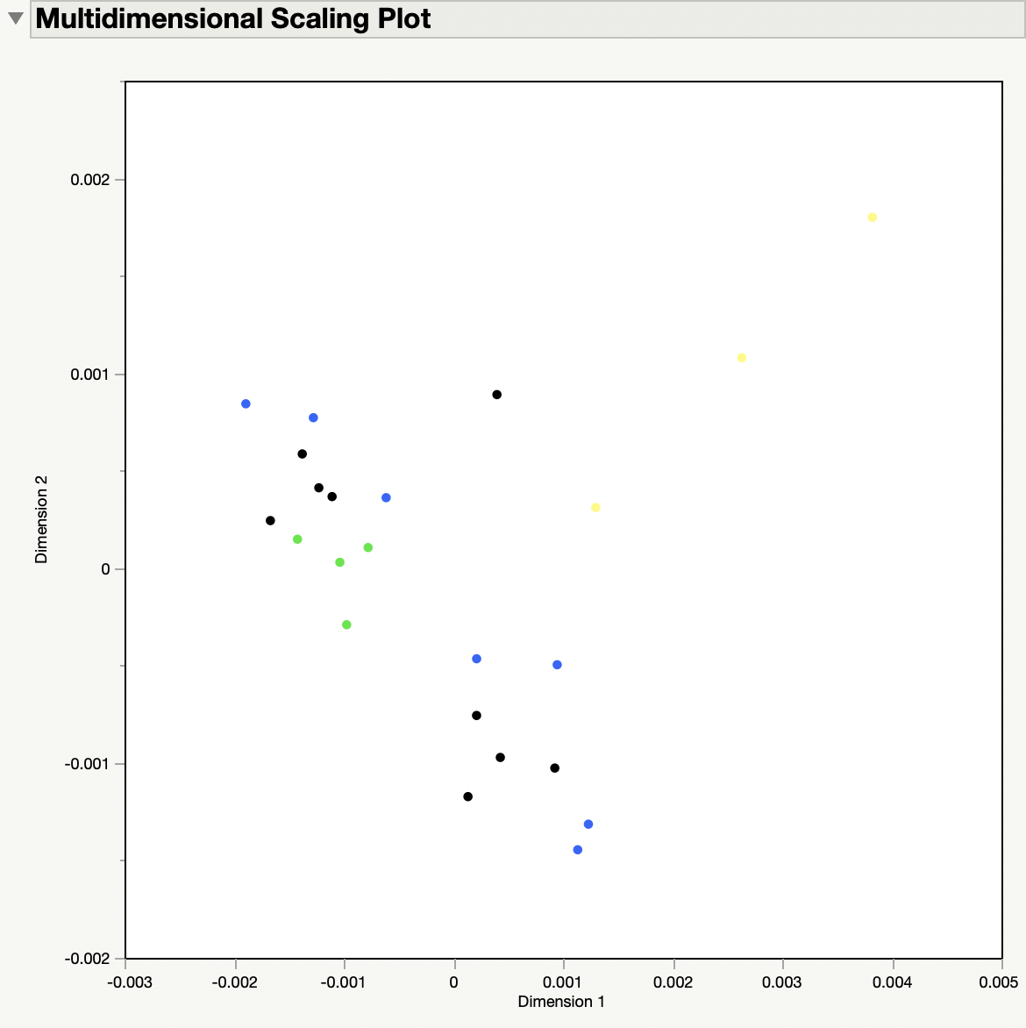
Proximity MDS – Cabral Day/Low
Yellow = Seep
Green = Close
Blue = Far

Slide 13
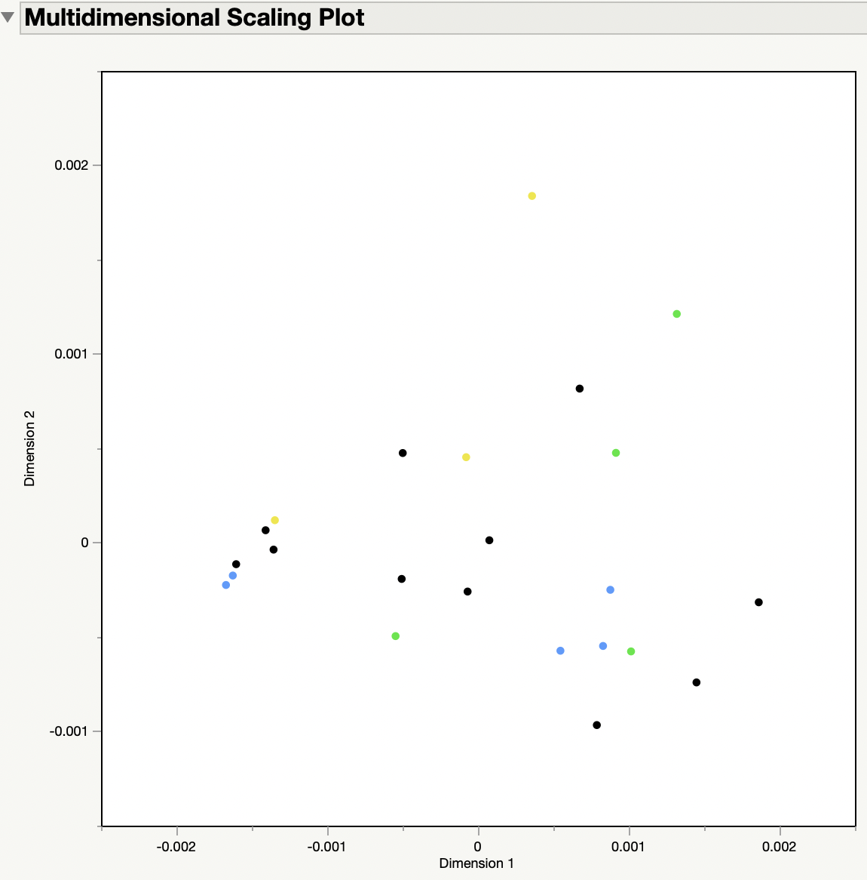
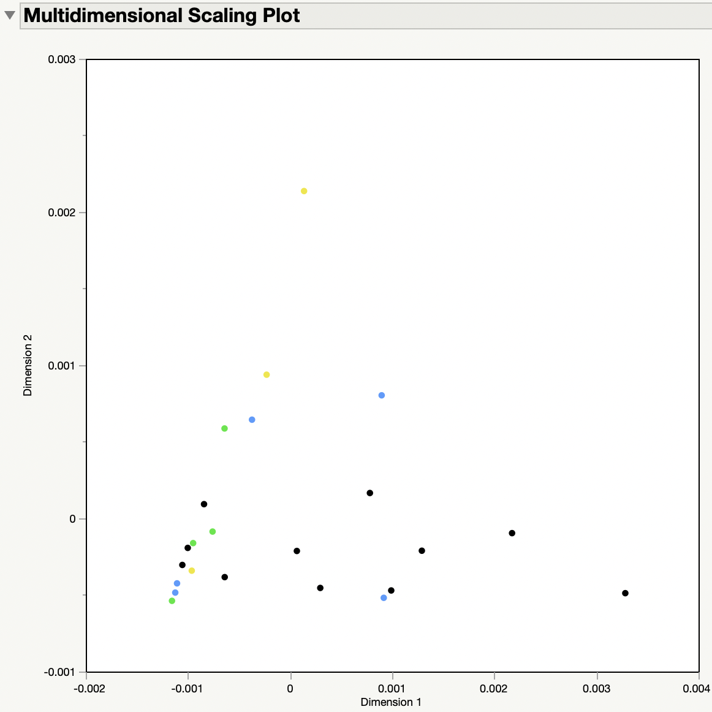
Proximity MDS – Verari Day/Low
“_2”
“_1”
Yellow = Seep
Green = Close
Blue = Far

Slide 14
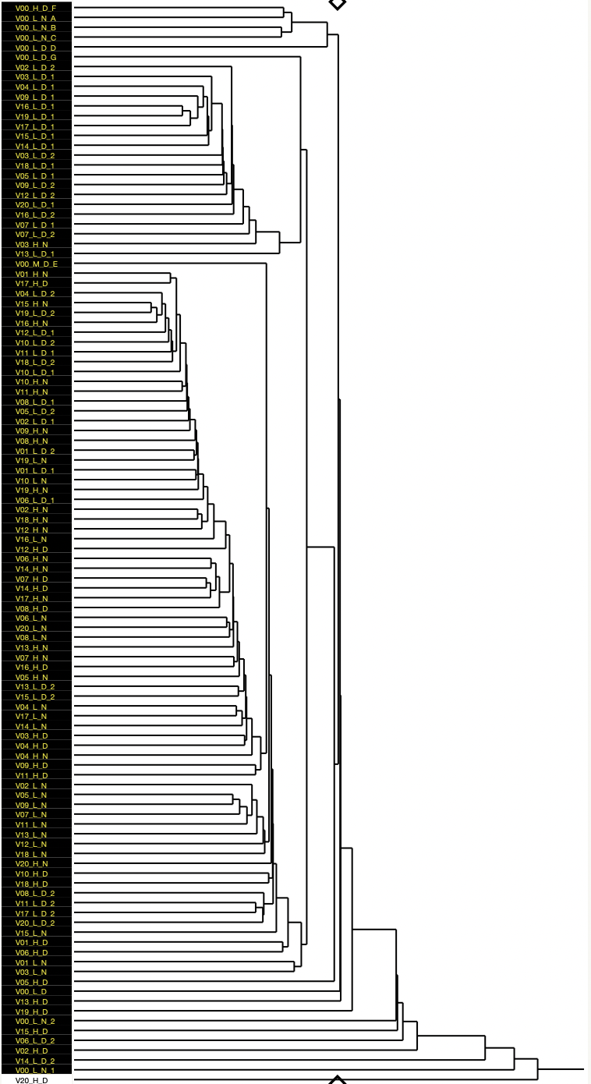
Hierarchal Clustering Verari
Seep
Low Day

Slide 15
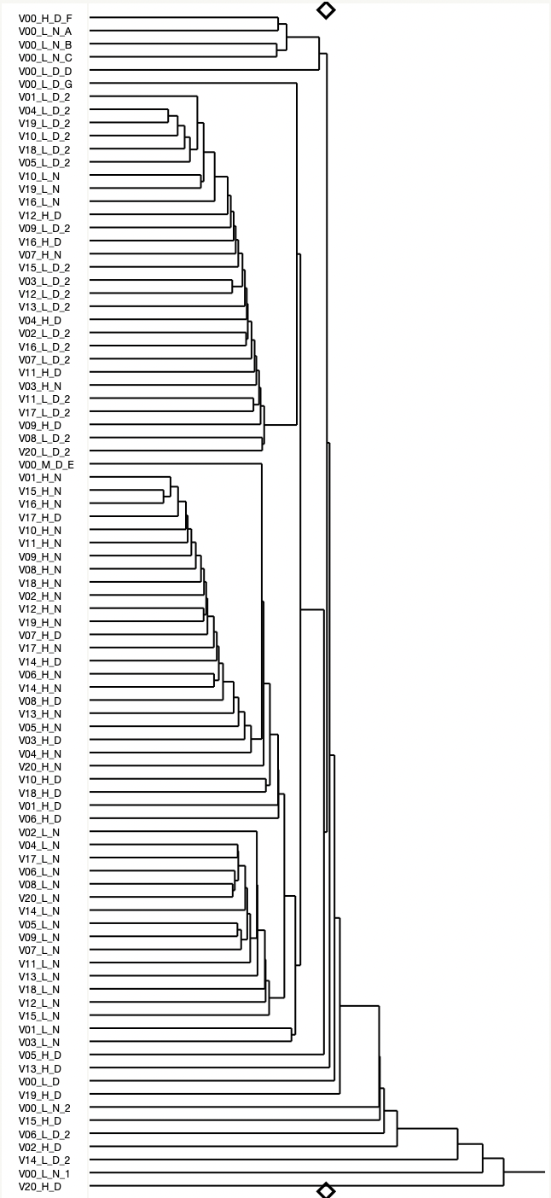
Hierarchal Clustering Verari “_2”
Seep
Low Day
High
This tells me that
Low Day Samples are closest to the seep samples
High and Low is the biggest difference
Then time difference
Less signal of day and night
Seep samples are different
Low Night

Slide 16
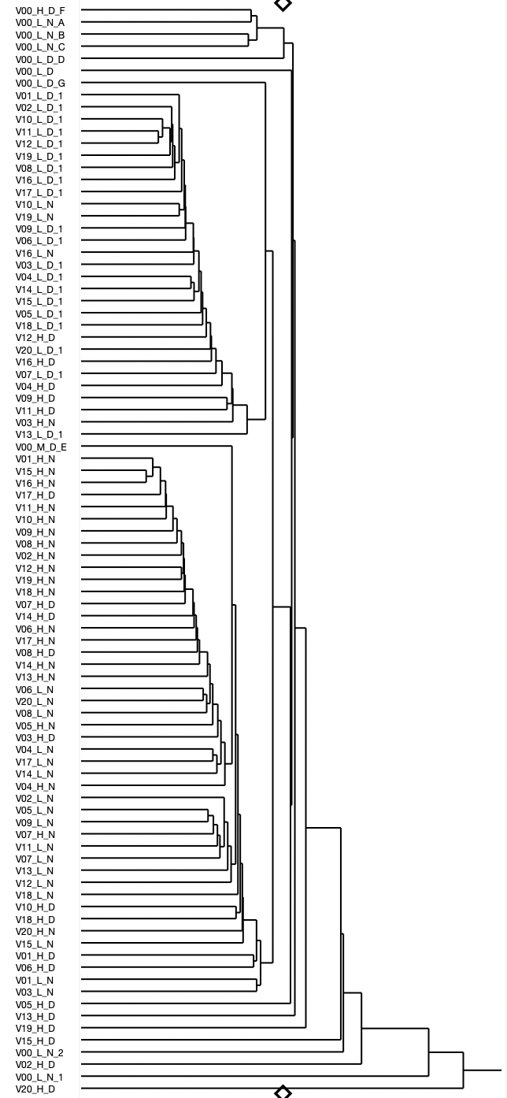
Hierarchal Clustering Verari “_1”
Seep
Low Day
High Night
This tells me that
Low Day Samples are closest to the seep samples
Day and Night is the biggest difference
Then Tide difference
High Day doesn’t have a strong signal
Seep samples are different
Low Night

Slide 17
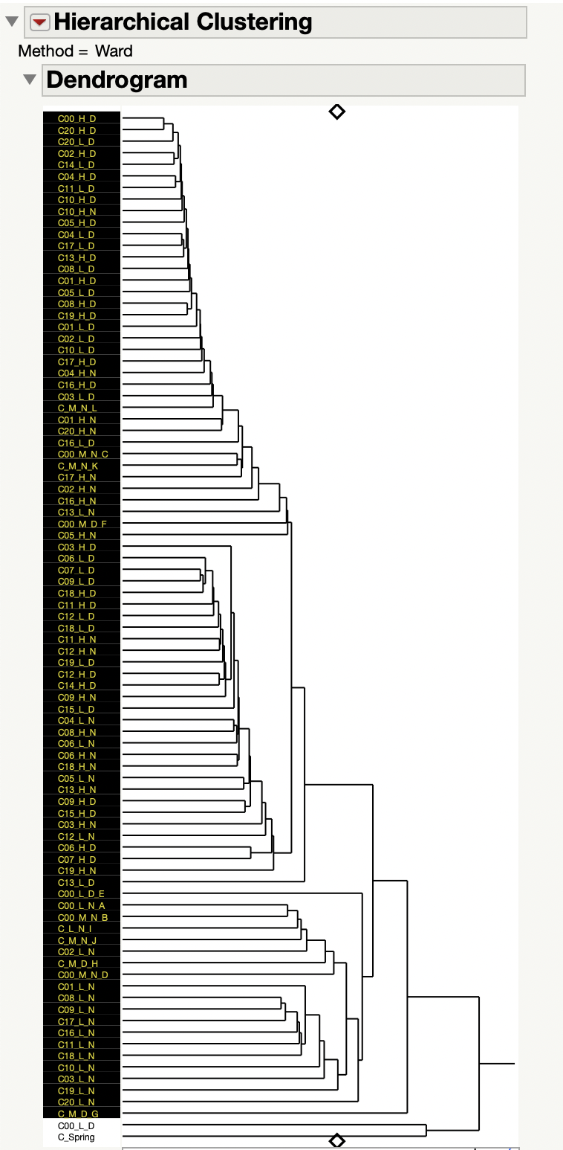
Hierarchal Clustering Cabral
Day
This tells me that
There is less of a pattern at Cabral
Day is clustering
Low Night is clustering
Seep samples are in the middle closest to Low Night
Seep
Low Night

Slide 18
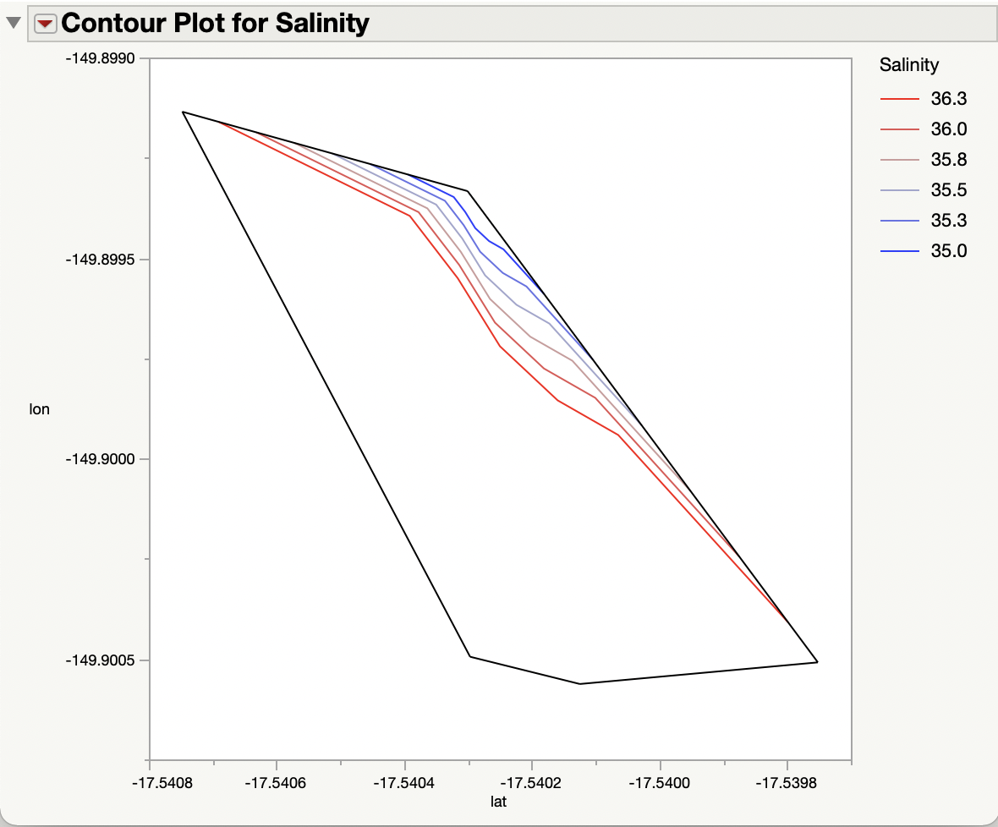
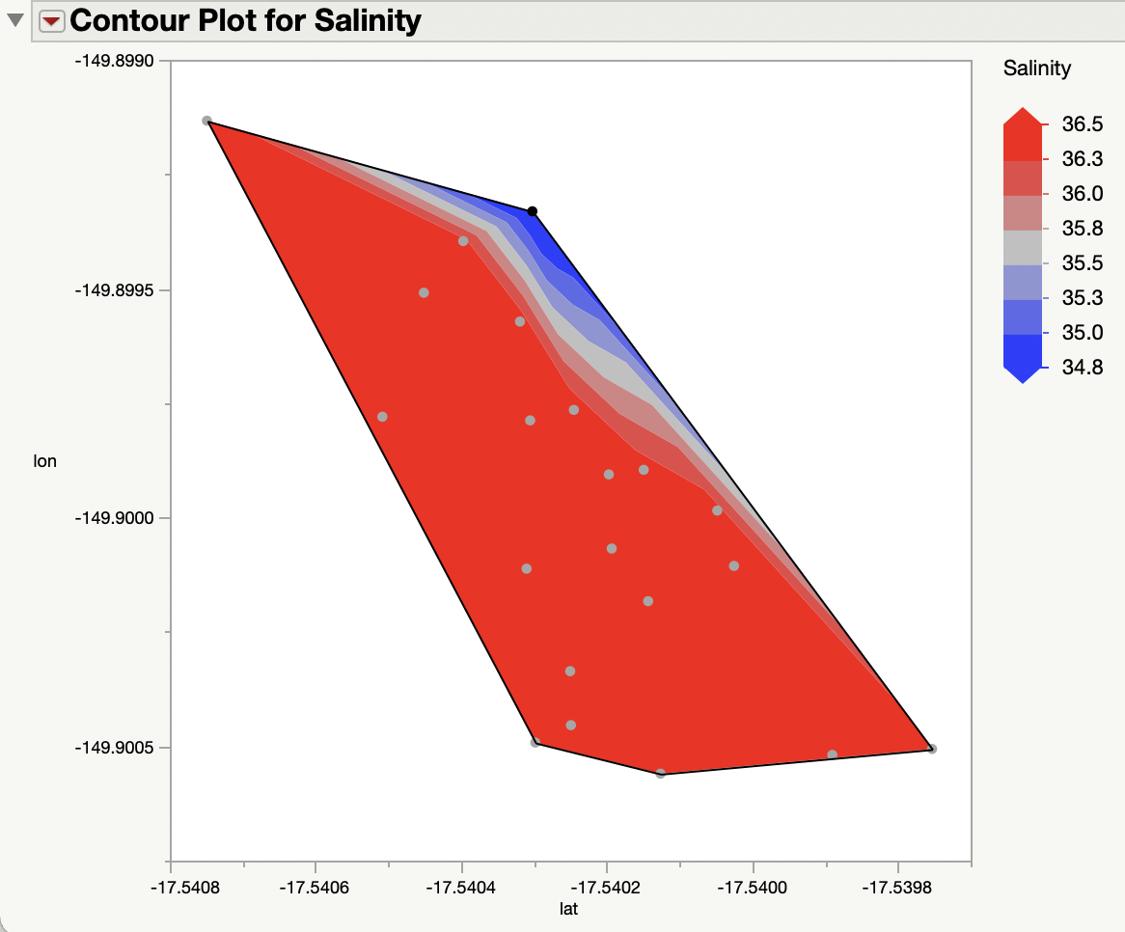
Contour Plot for Salinity - Verari
Seep

Slide 19
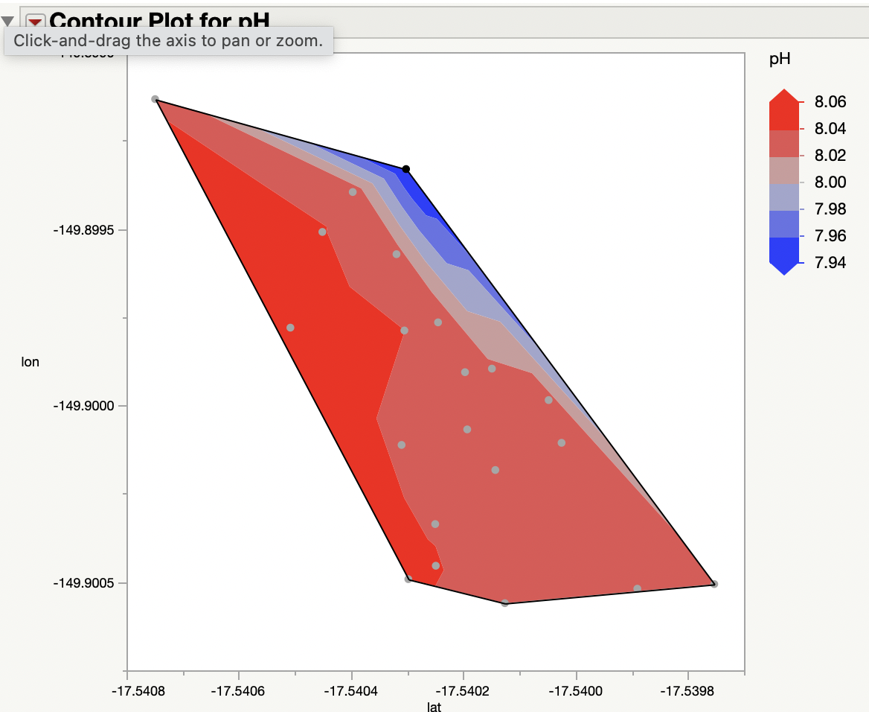
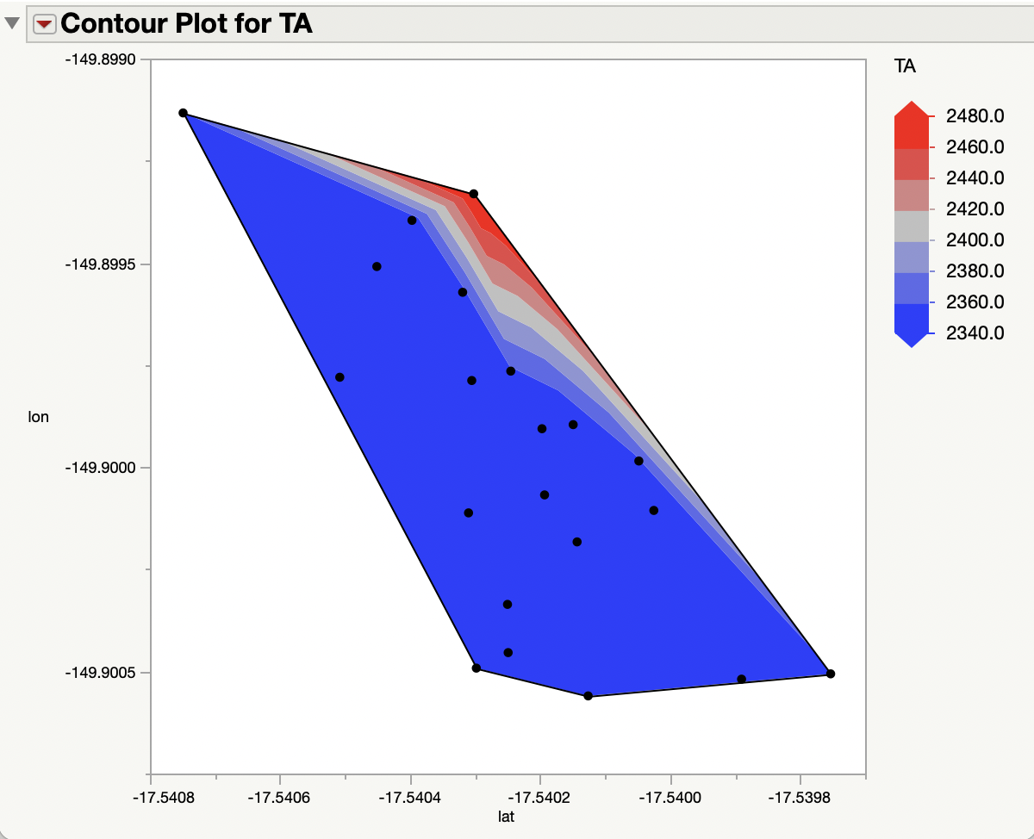
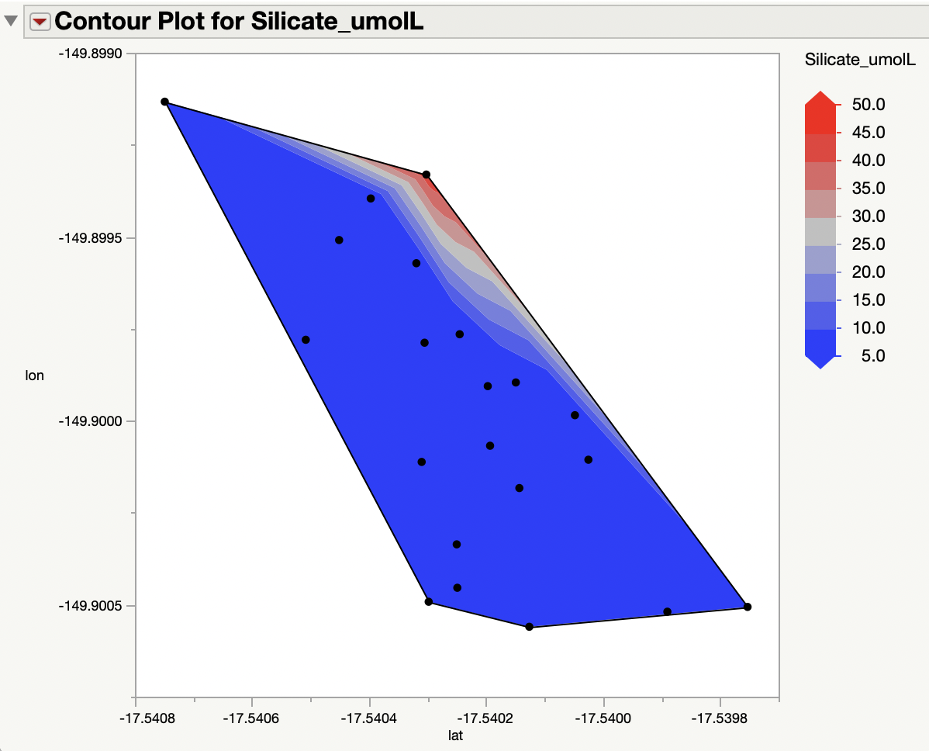
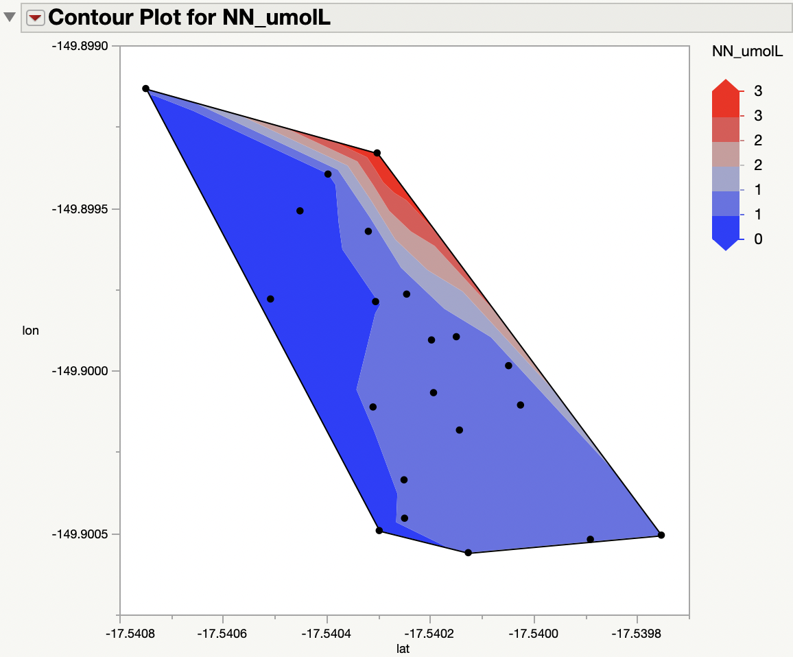
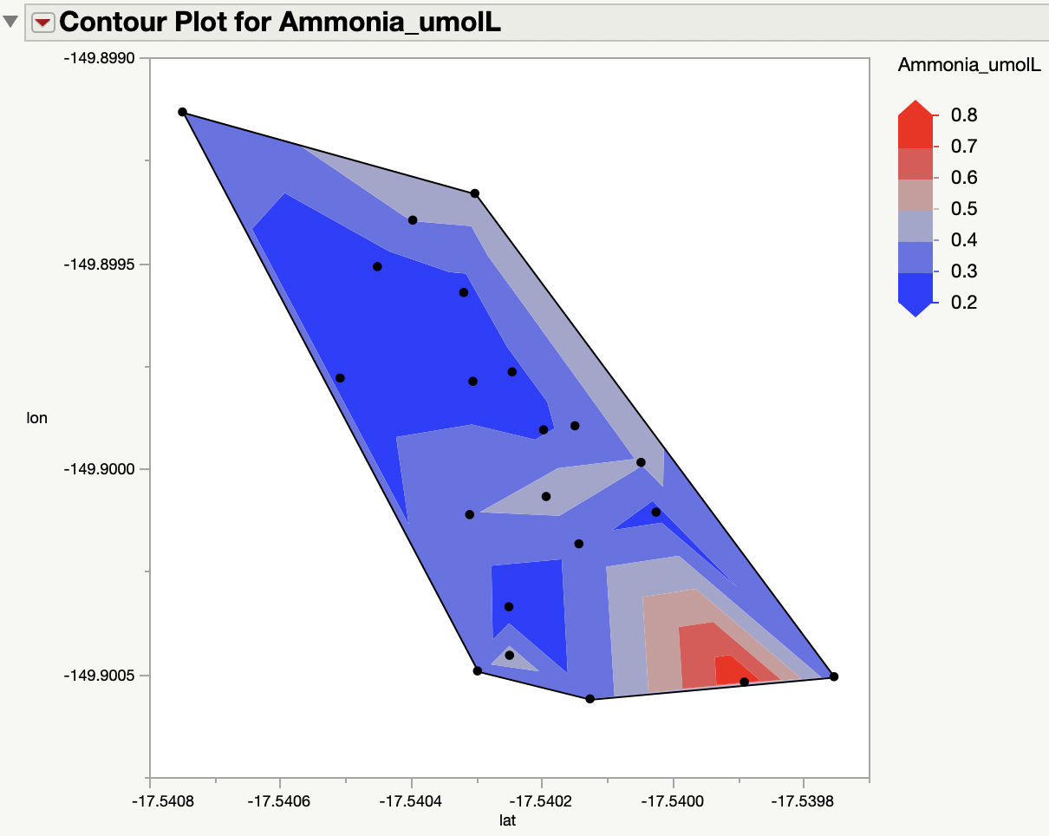
Contour Plots for Verari
Seep

Slide 20
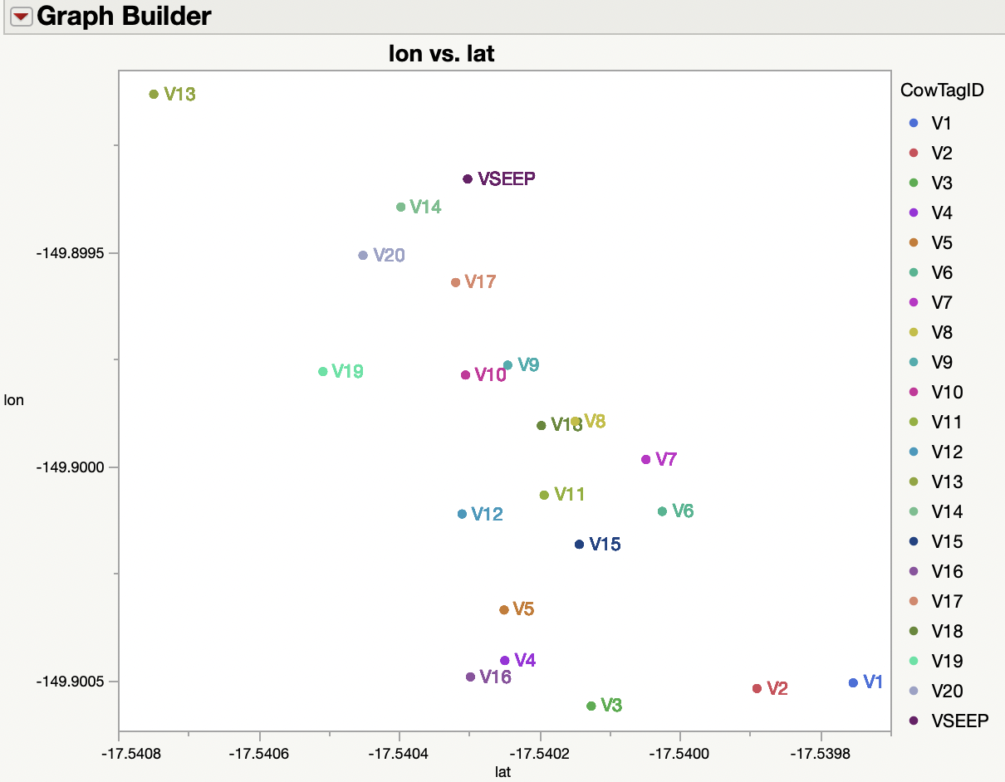
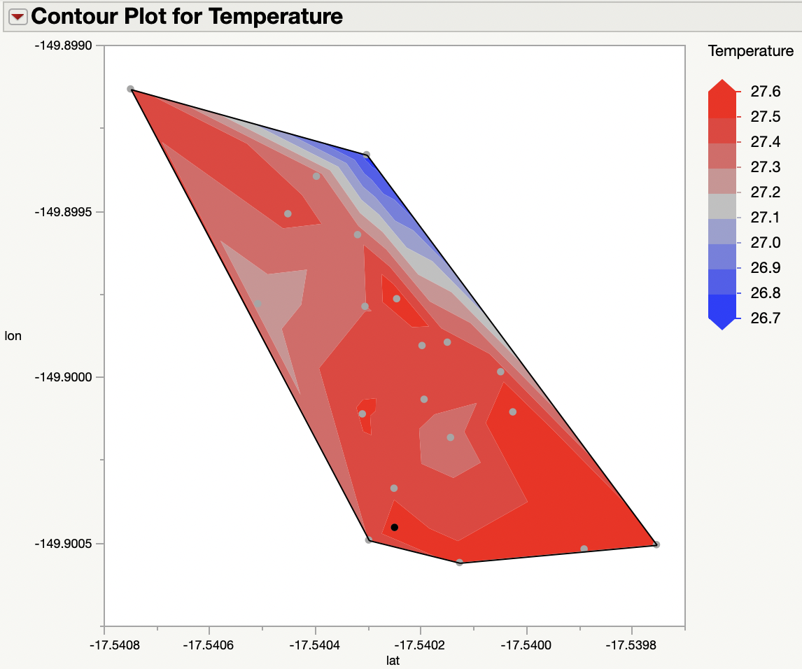
Closest to Seep: V14, V17, V9, V8, V18, V7
Farthest from Seep: V16, V3, V4, V5, V2, V13

Slide 21
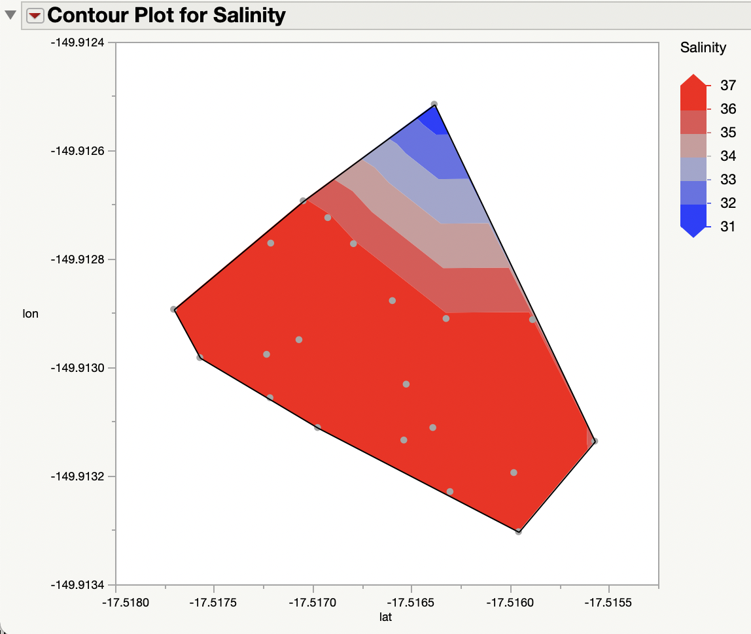
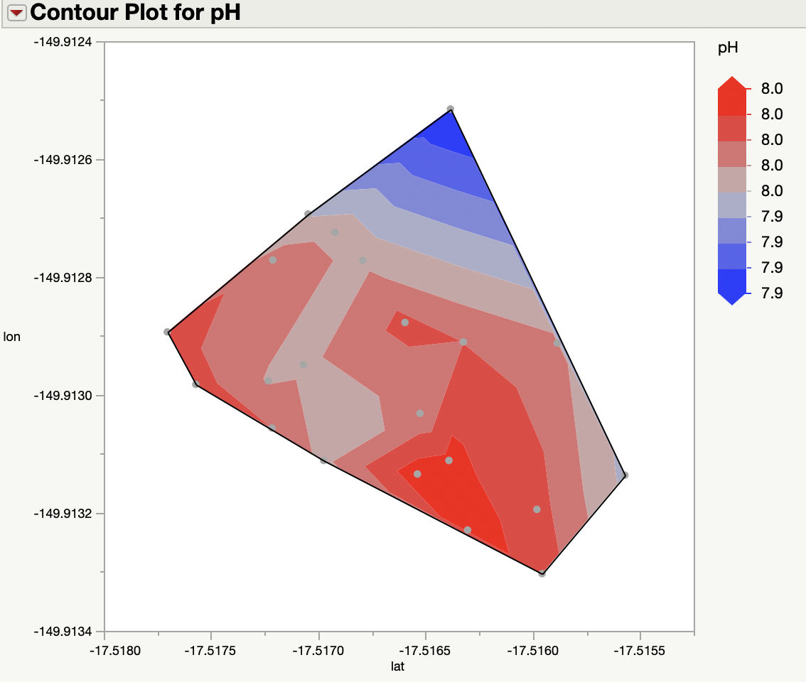
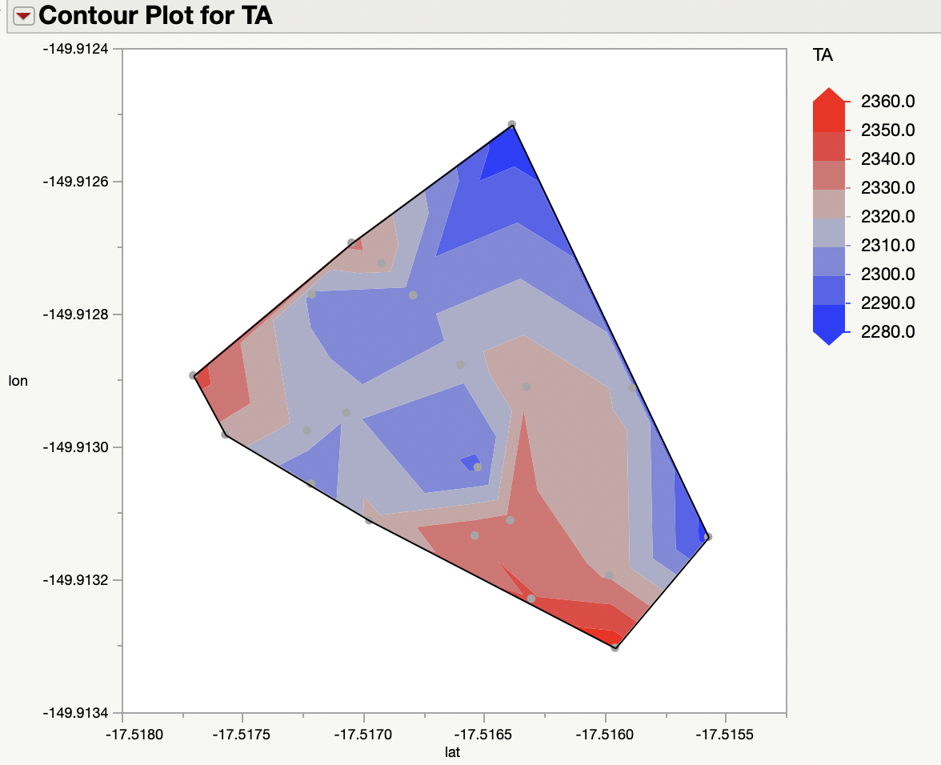
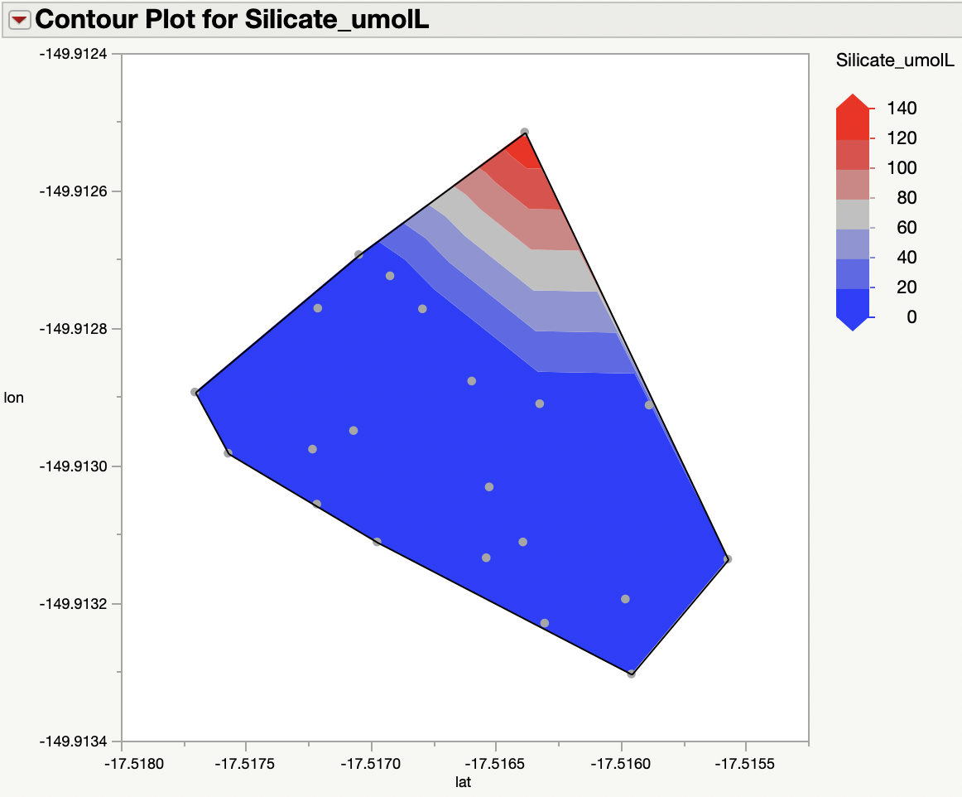
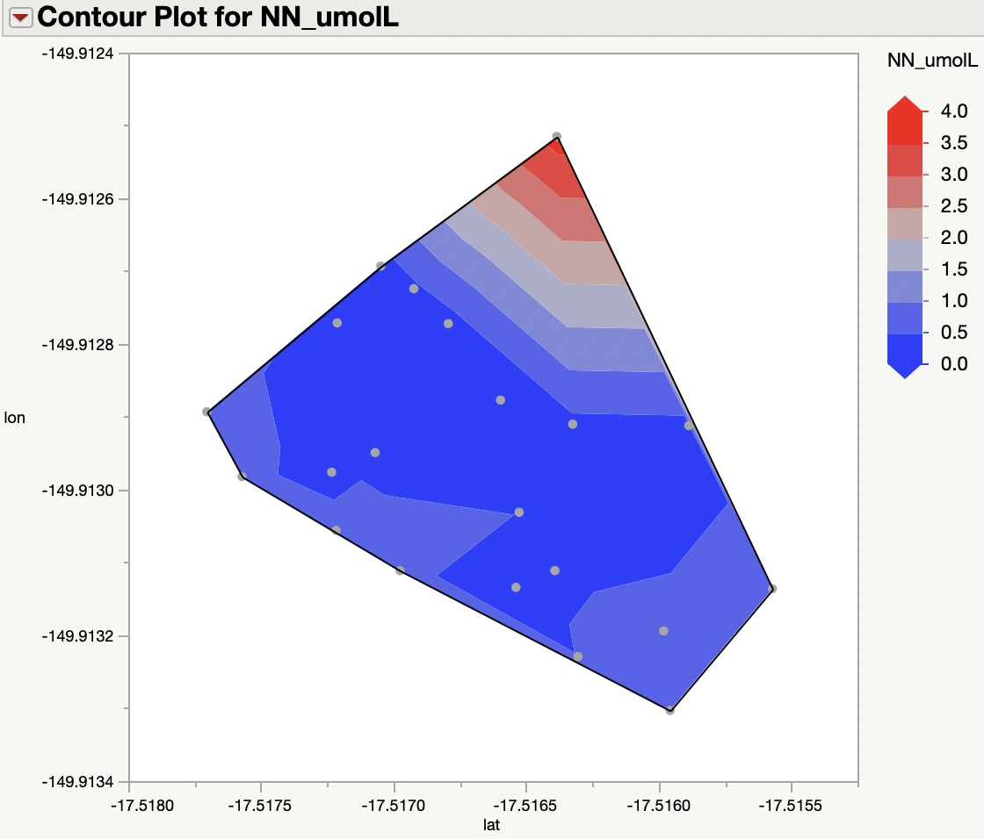
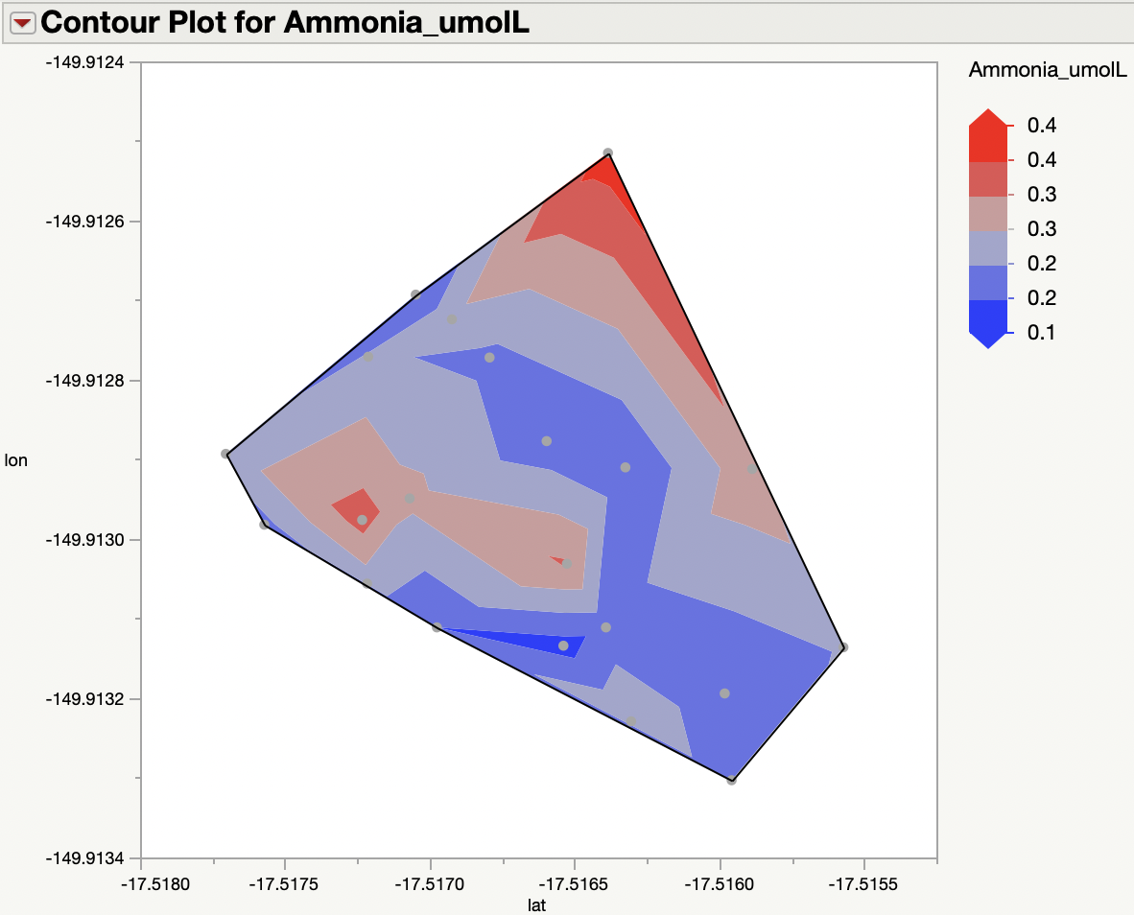
Contour Plots for Cabral
Seep

Slide 22
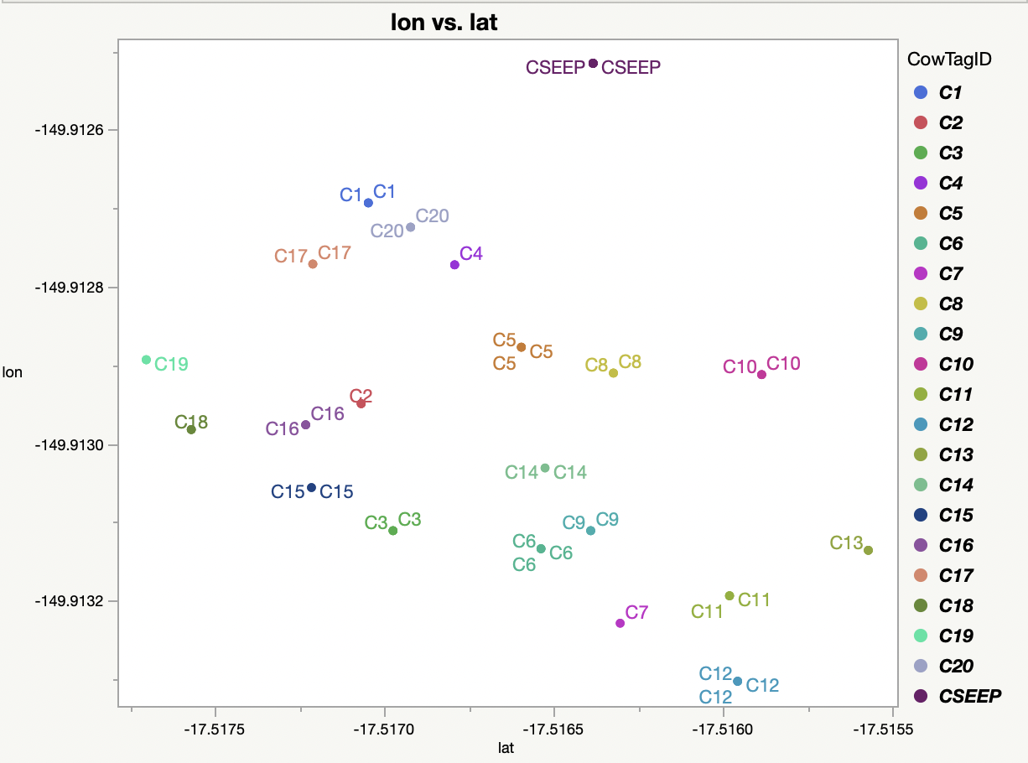
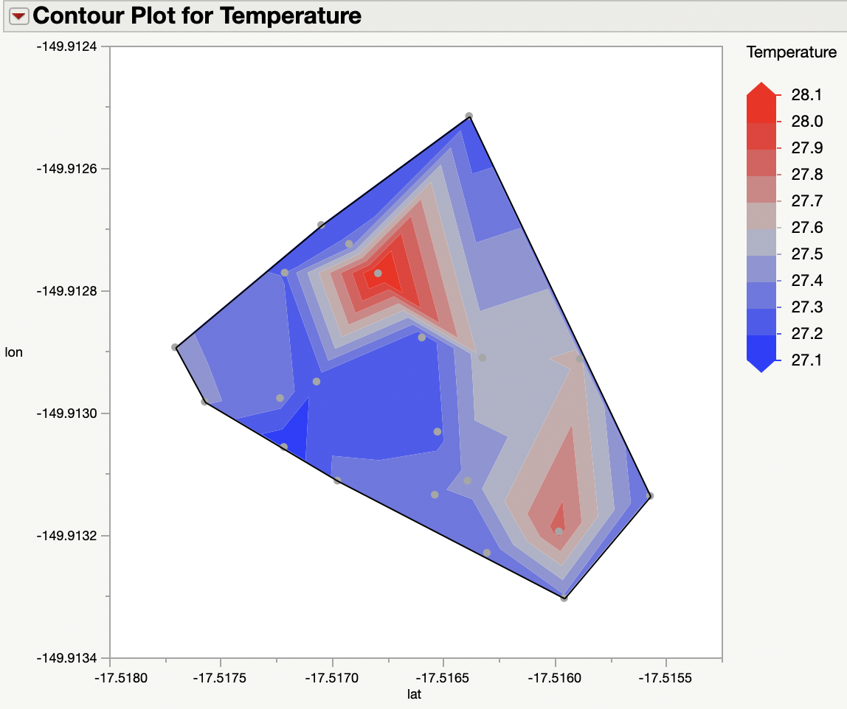
Closest to Seep: C1, C20, C4, C2, C10, C13
Farthest from Seep: C7, C6, C9, C12, C18, C19

Slide 23
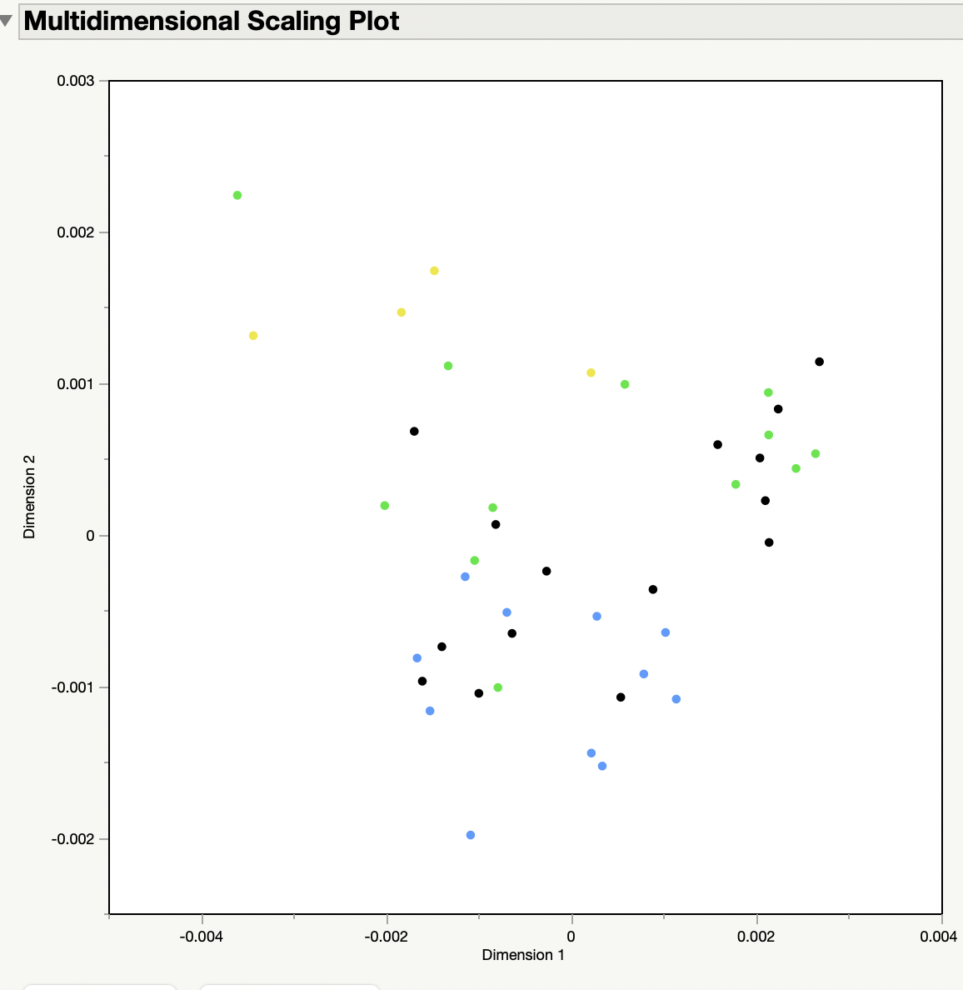
MDS Plot – Cabral Low New Proximity designations using pH
Seep
Close
Far

Slide 24
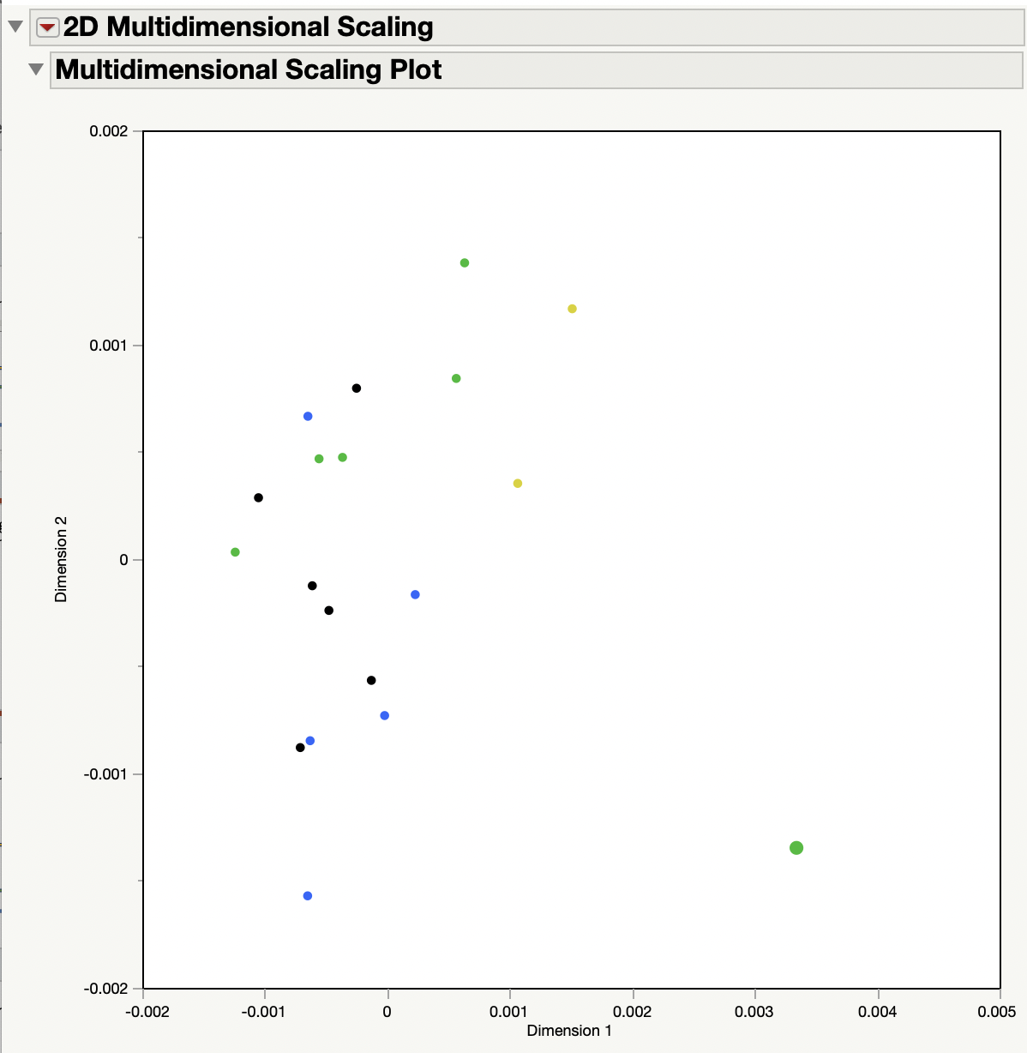
MDS Plot – Cabral Low/Night New Proximity designations using pH

Slide 25
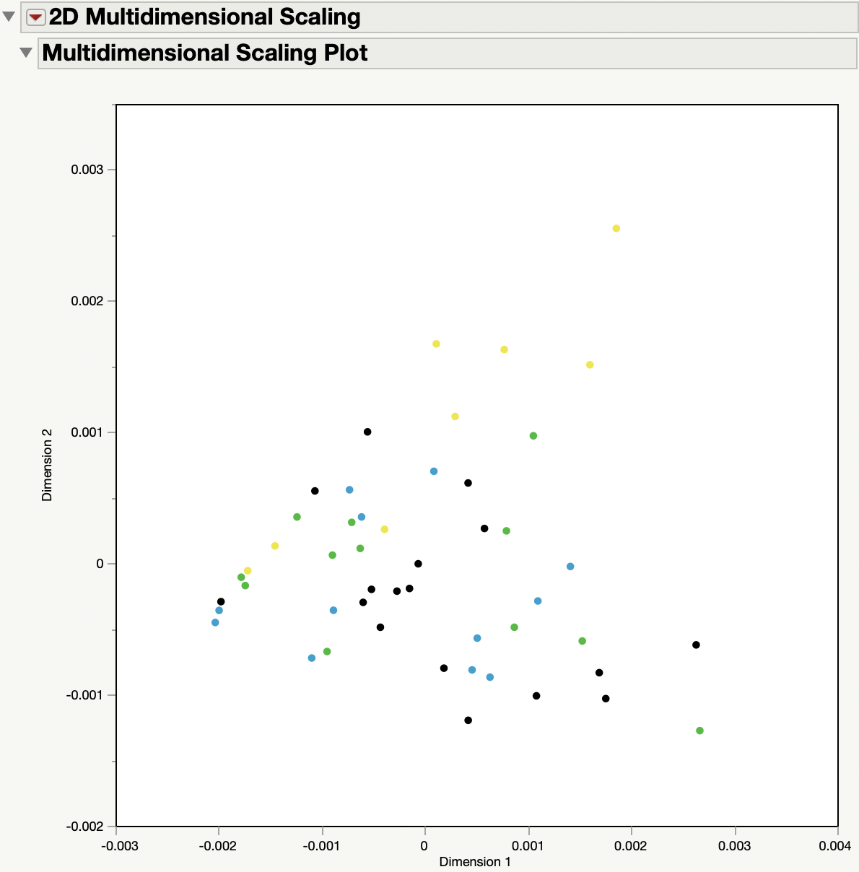
MDS Plot – Verari_2 Low New Proximity designations using pH
Seep
Close
Far

Slide 26
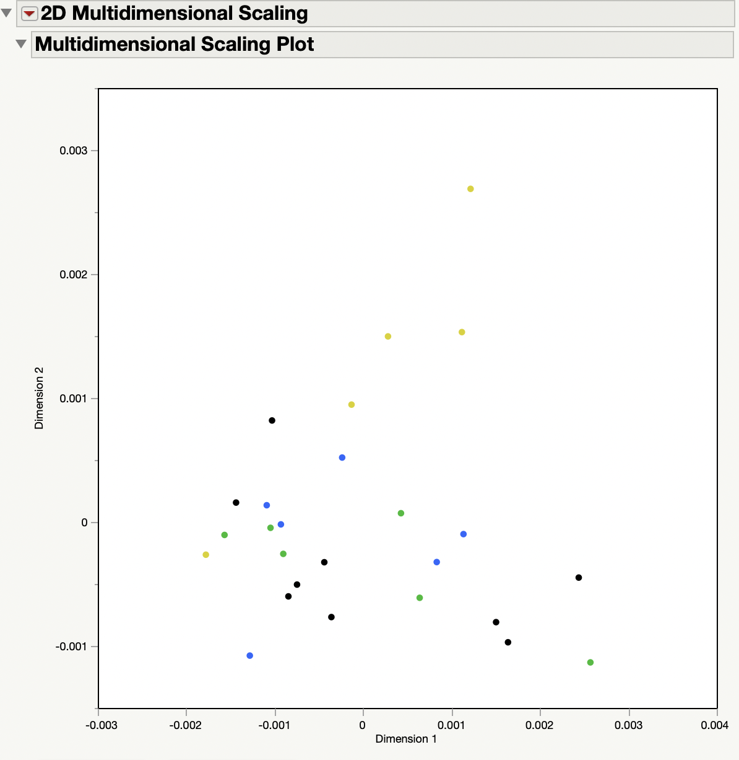
MDS Plot – Verari Low/Night New Proximity designations using pH

Slide 27
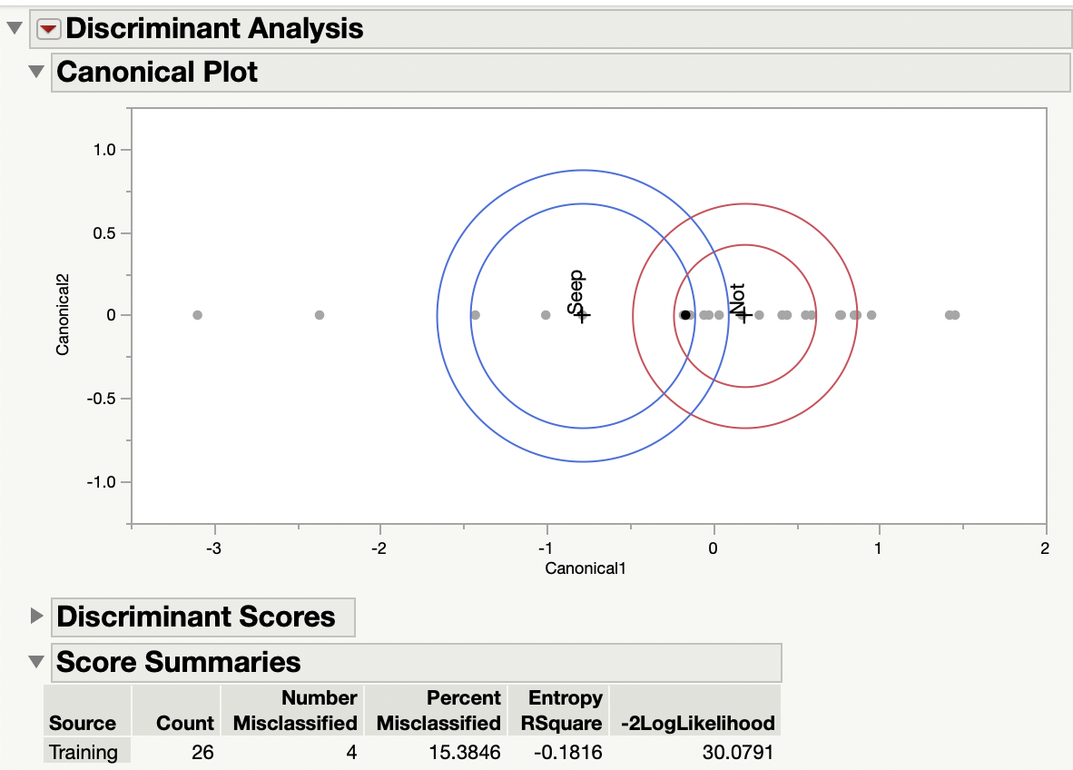
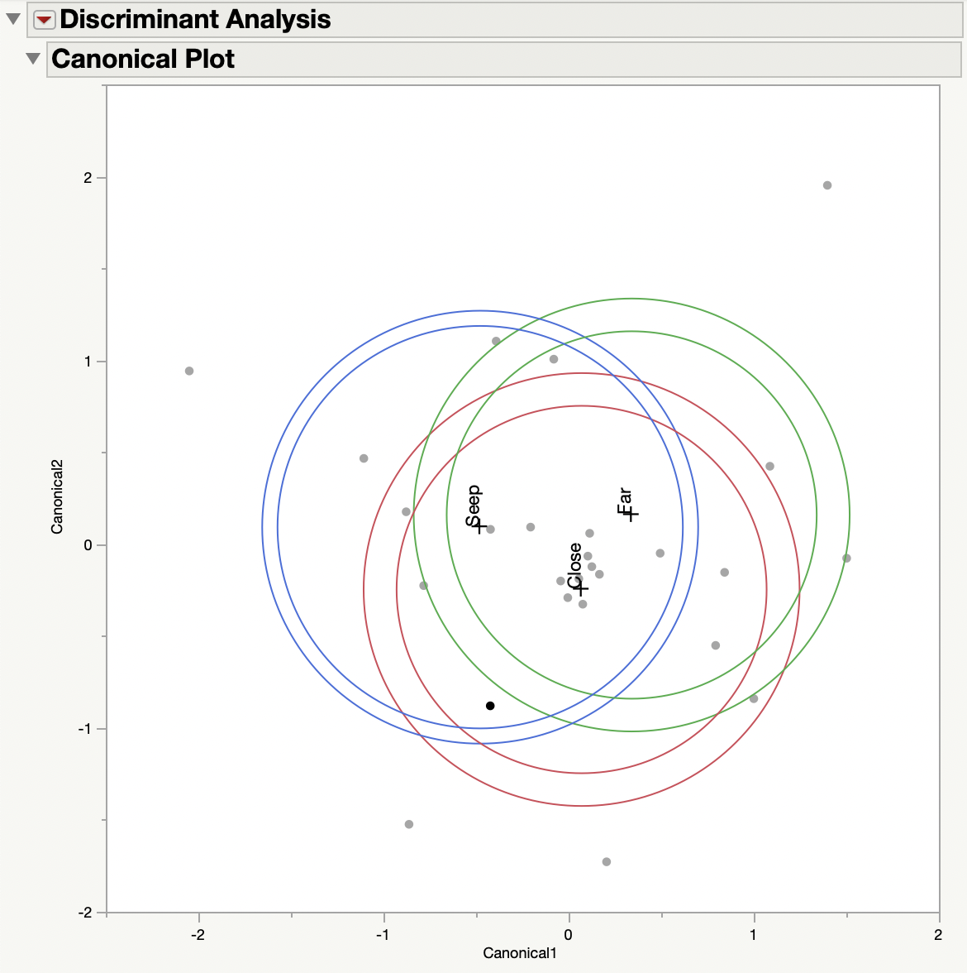
Discriminant Analysis - Varari Low/Night

Slide 28
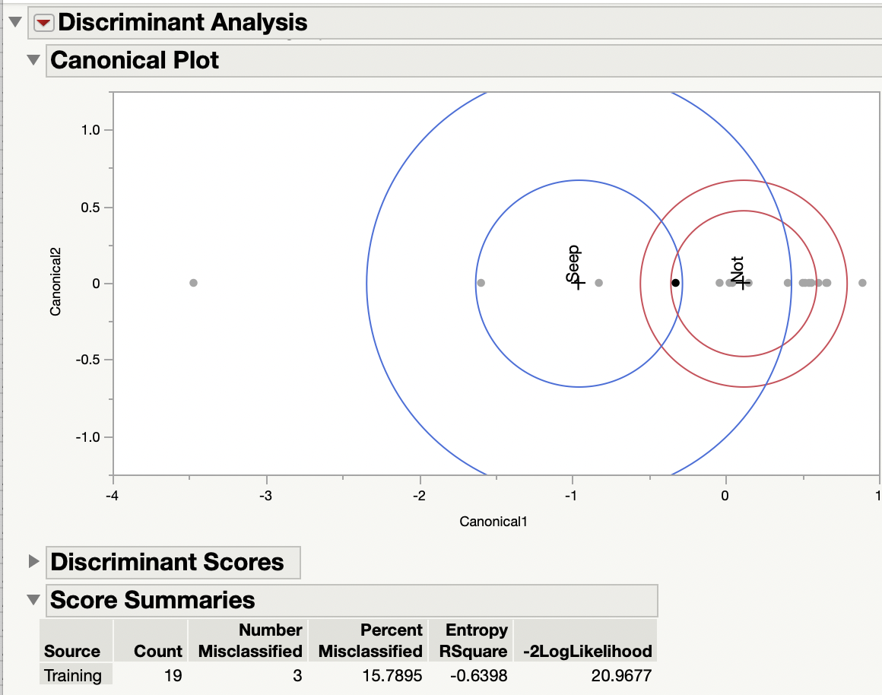
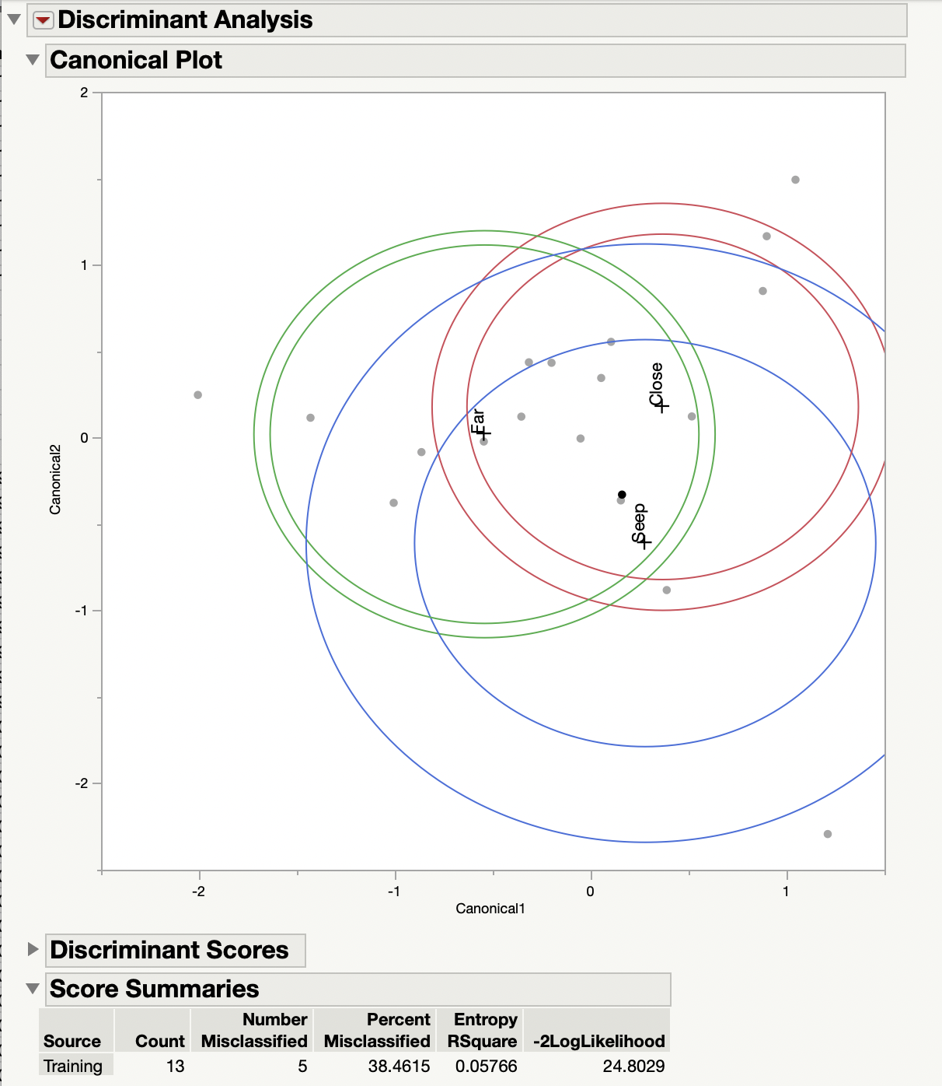
Discriminant Analysis - Cabral Low/Night

Slide 29
Contamination
Major human bacterial pathogens in wastewater include Salmonella spp., Escherichia spp., Shigella spp., Yersinia spp., Klebsiella spp., Leptospira spp., Vibrio cholerae, Aeromonas hydrophila, Legionella pneumophila, Mycobacterium spp., and Pseudomonas
https://www.ncbi.nlm.nih.gov/pmc/articles/PMC7126130/
OTU00136 (vibrio) is abundant in all Verari samples
OTU00224 (vibrio) is abundant in many samples
OTU00356 (vibrio)
OTU00093(Pseudomonadaceae_unclassified)
First cluster by site:

Slide 30
Method of Contaminate ID
Found Genus’s on the list associated with wastewater from paper on previous slide
Compiled them into a spreadsheet with site information
Took the sum of the abundance of all the contaminate OTU’s together
Contour plot of lat/lon and SUM to find where contaminates were located

Slide 31
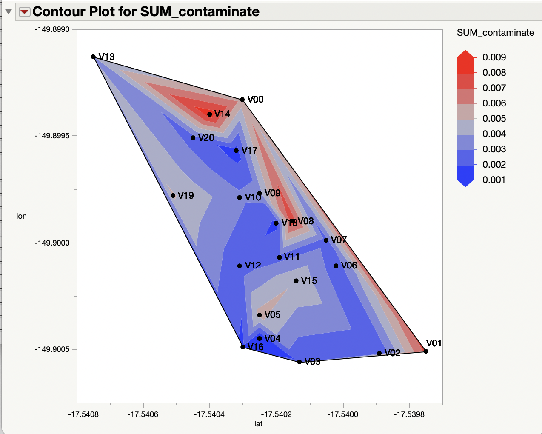
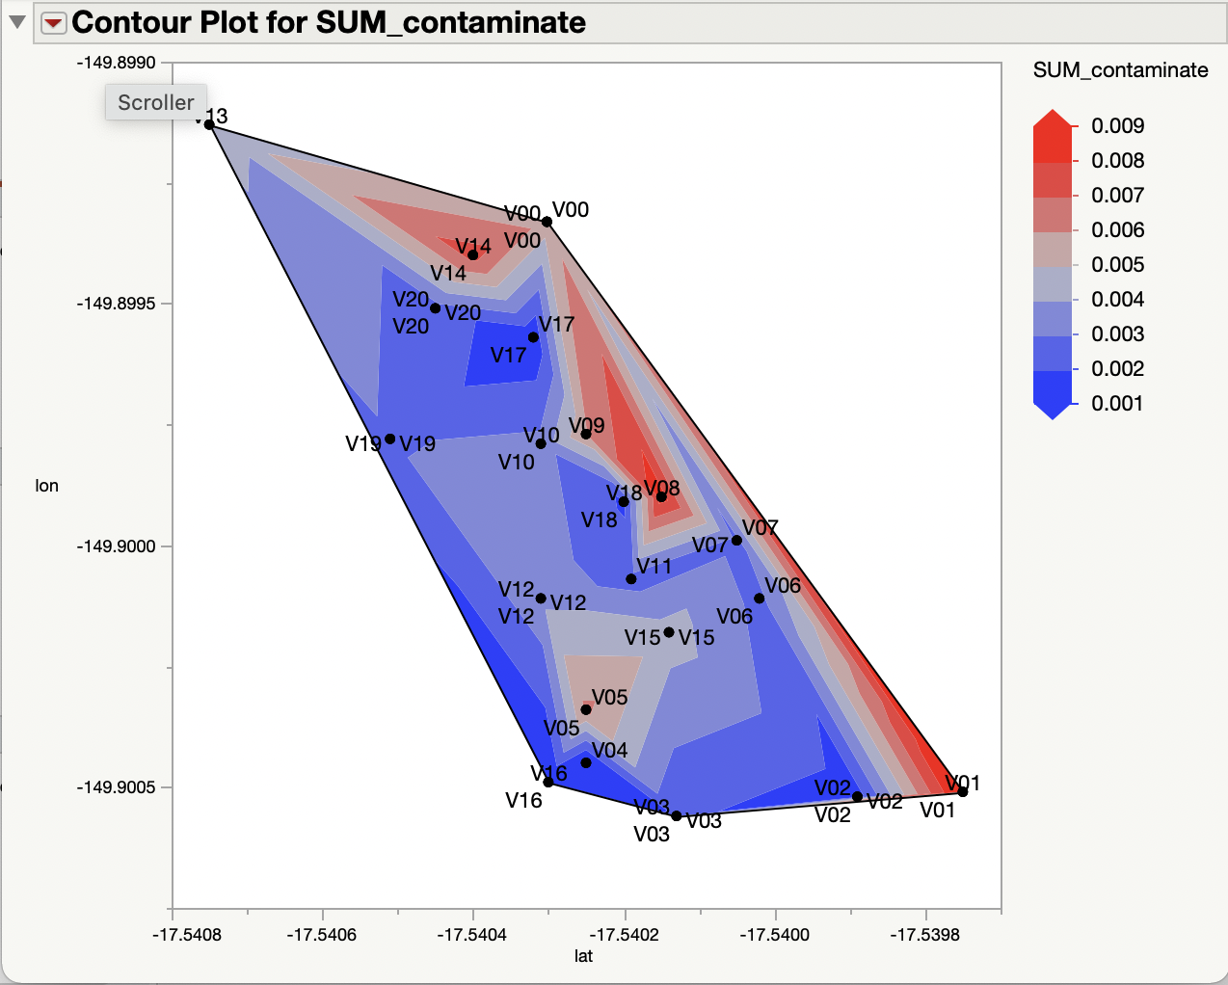
Verari Contamination ALL
“_2”
“_1”

Slide 32
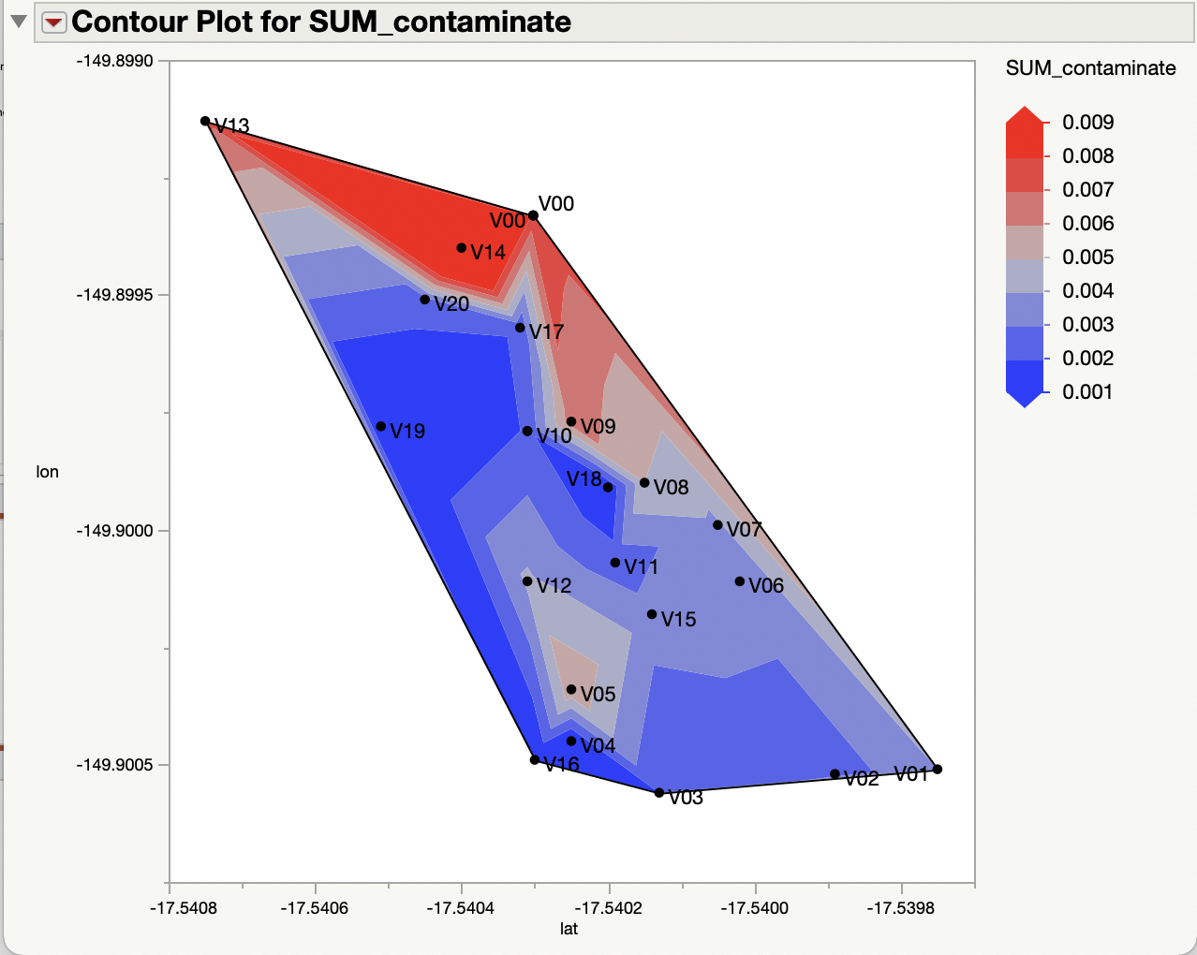
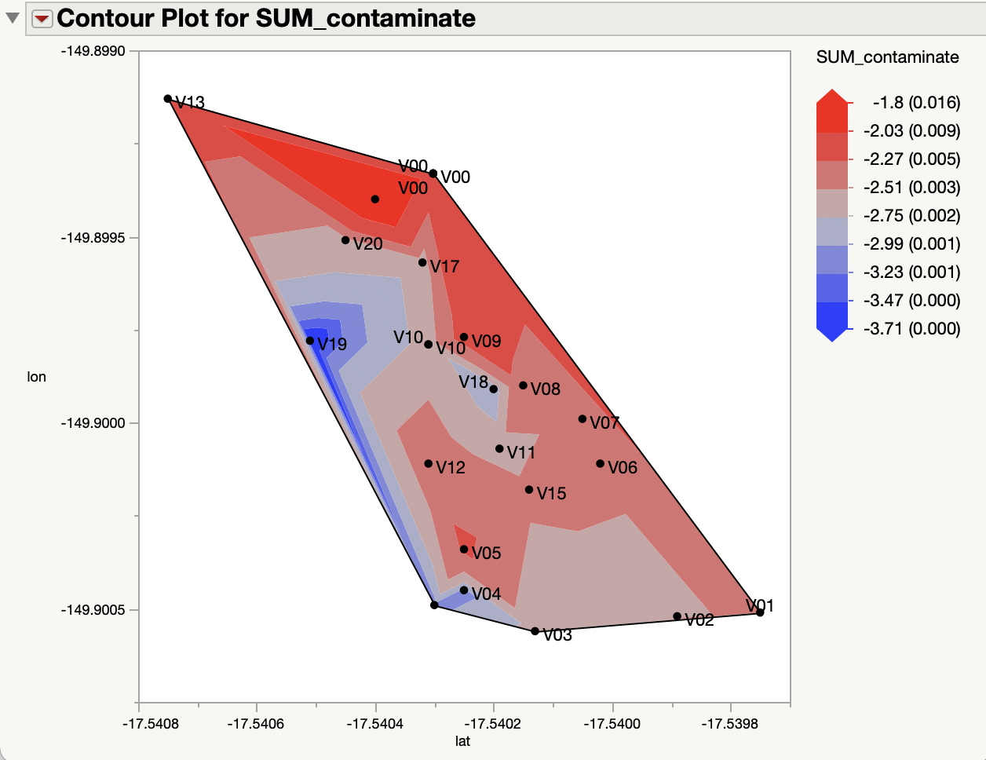
Verari Contamination Low/Night
Gradient: Log + Middle 90%

Slide 33
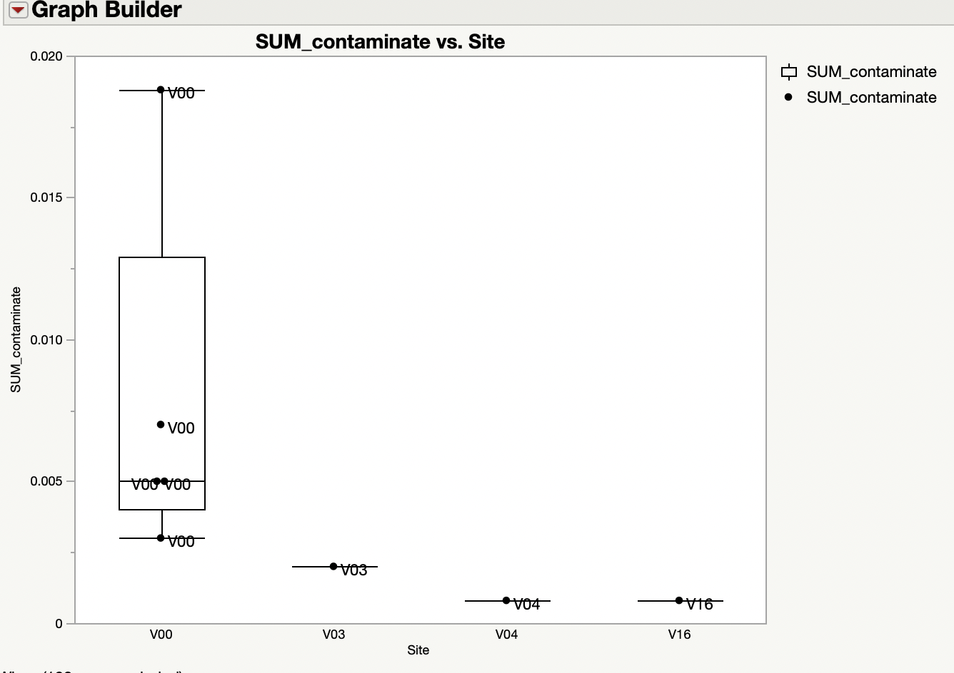
Contaminate Abundance at Verari Seep at Low/Night
Farthest Sites from Seep

Slide 34
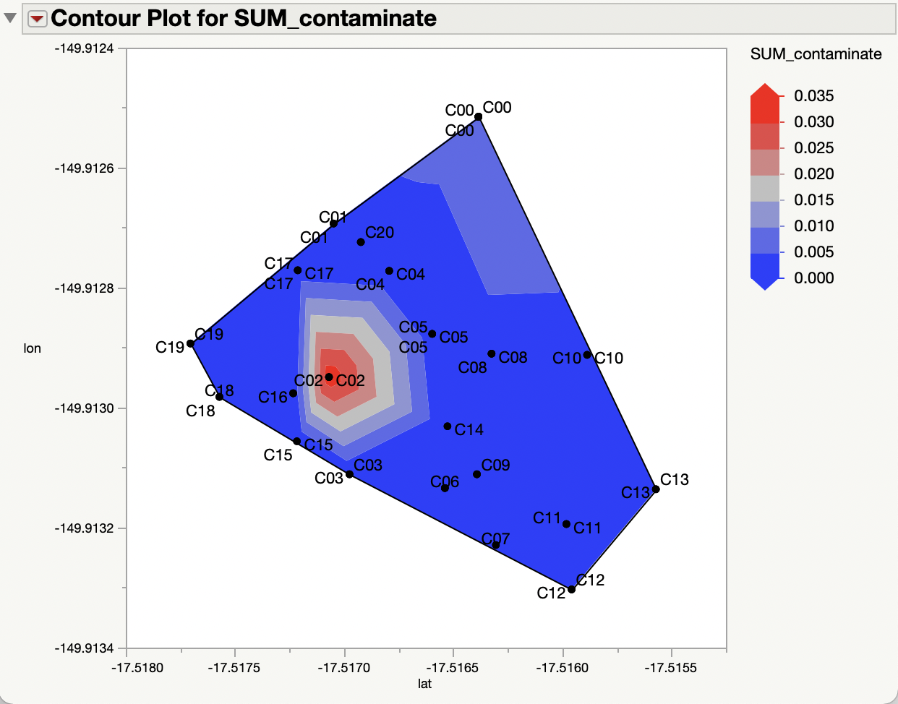

Cabral Contamination ALL
Gradient: Log + Middle 90%

Slide 35


Cabral Contamination Low/Night
Gradient: Log + Middle 90%

Slide 37

Contaminate Abundance at Verari Seep at Low/Night

